Slide 1

Opinion article

Slide 2
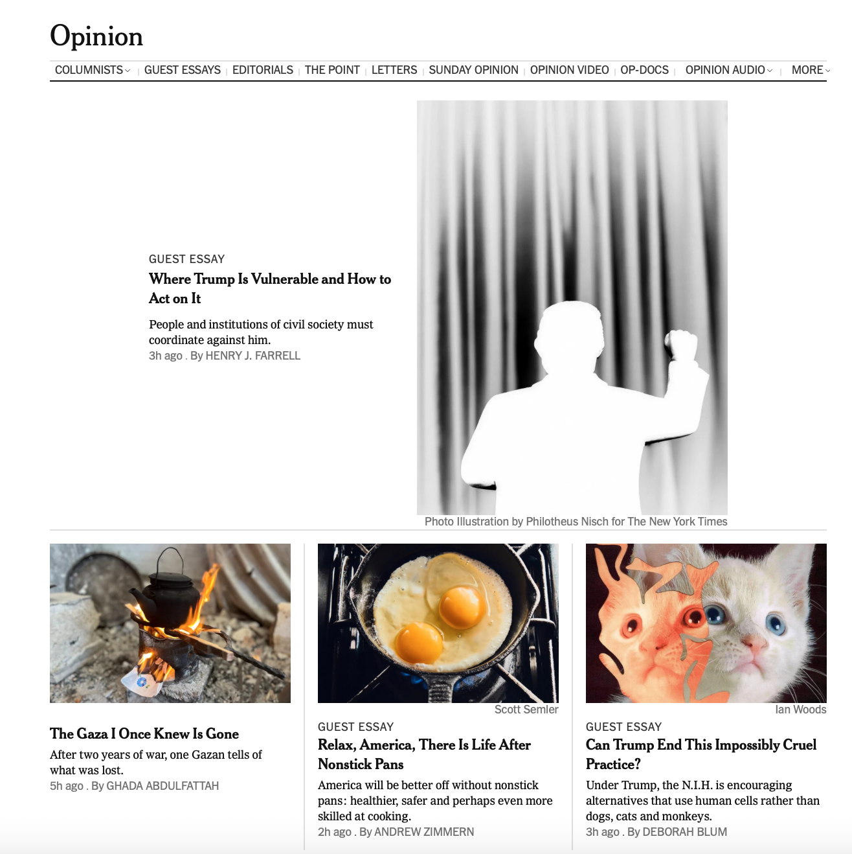
op-ed/opinion story:
A feature story with a clear opinion. Its goal: to persuade people to your point of view.

Slide 3
What must a good opinion story have?
News hook – why this topic right now?
Audience – must be relevant and interesting to readers/viewers/listeners
Must have a distinct point of view
Usually has some controversy

Slide 4
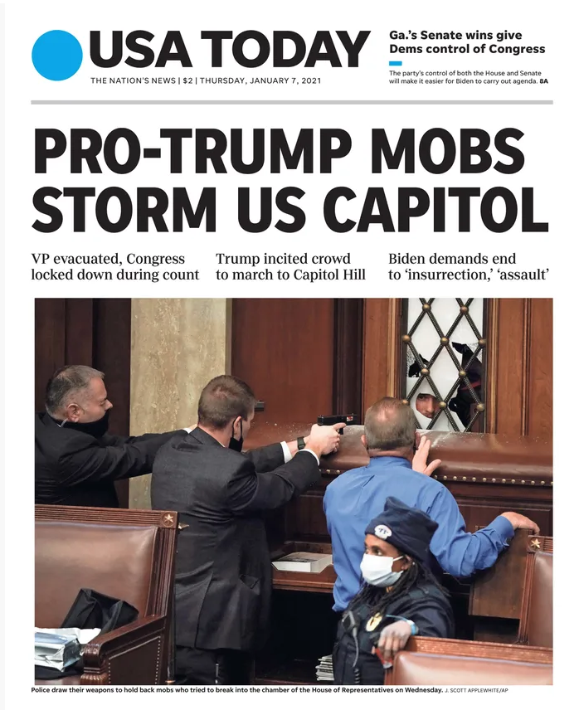
This is the news story in USA Today

Slide 5

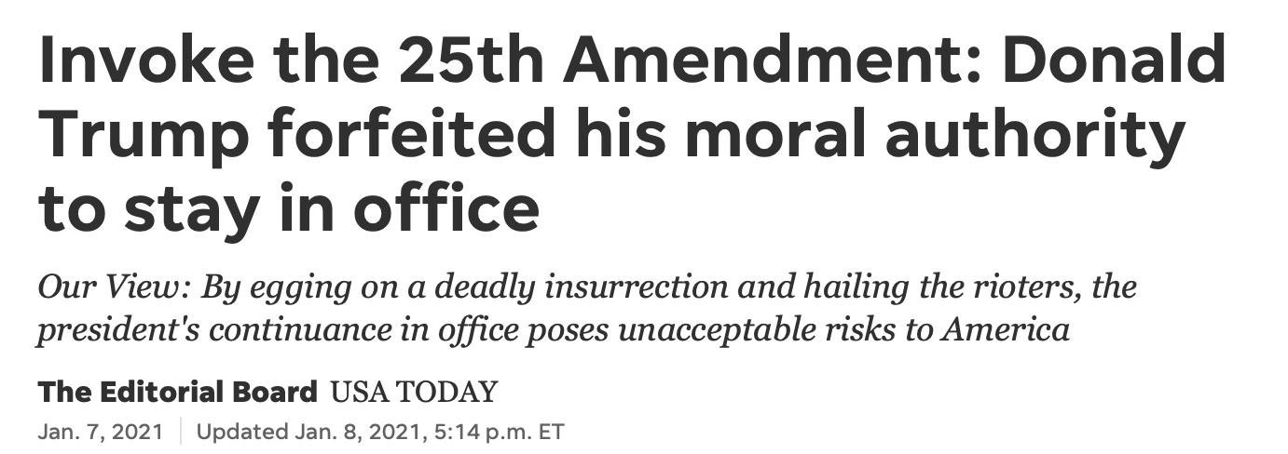
Here’s the op-ed/opinion article that followed

Slide 6

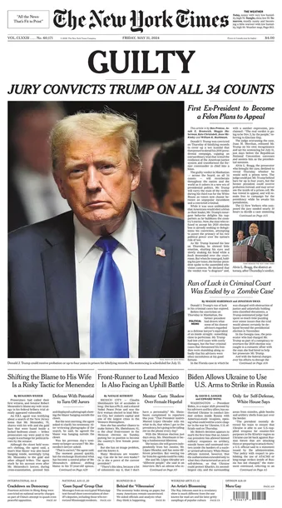
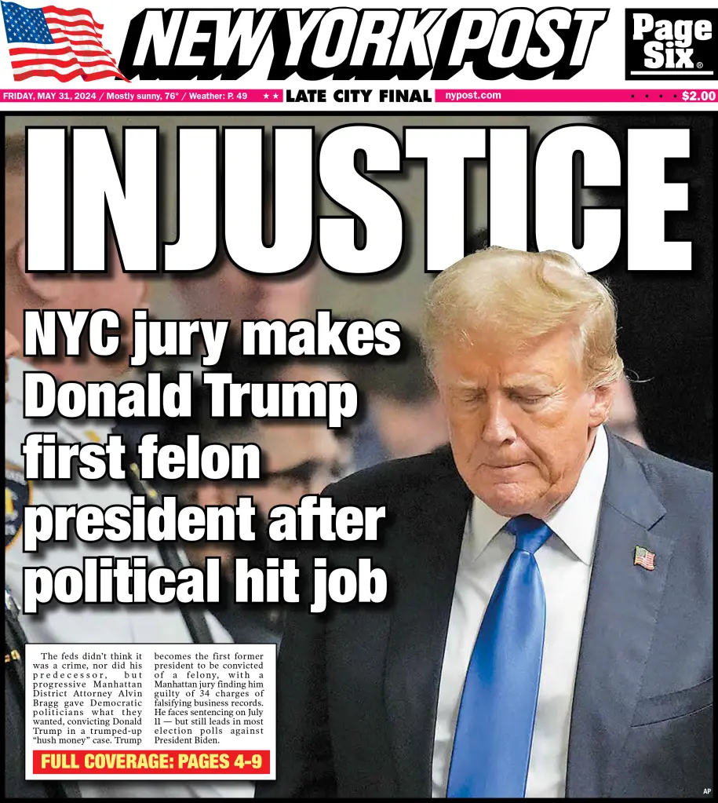
Op-ed should fit the news outlet’s audience

Slide 7

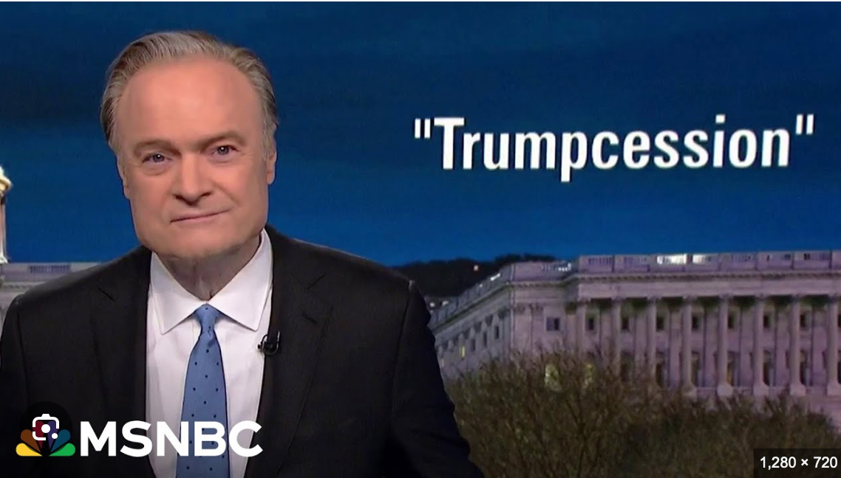
Fox News Opinion vs MS Now (former MSNBC)

Slide 8


Op-ed should be pitched toward the tone, style and audience of the publication or outlet

Slide 9



Slide 10

In a newspaper, who writes the op-eds that speaks for institution?

Slide 11
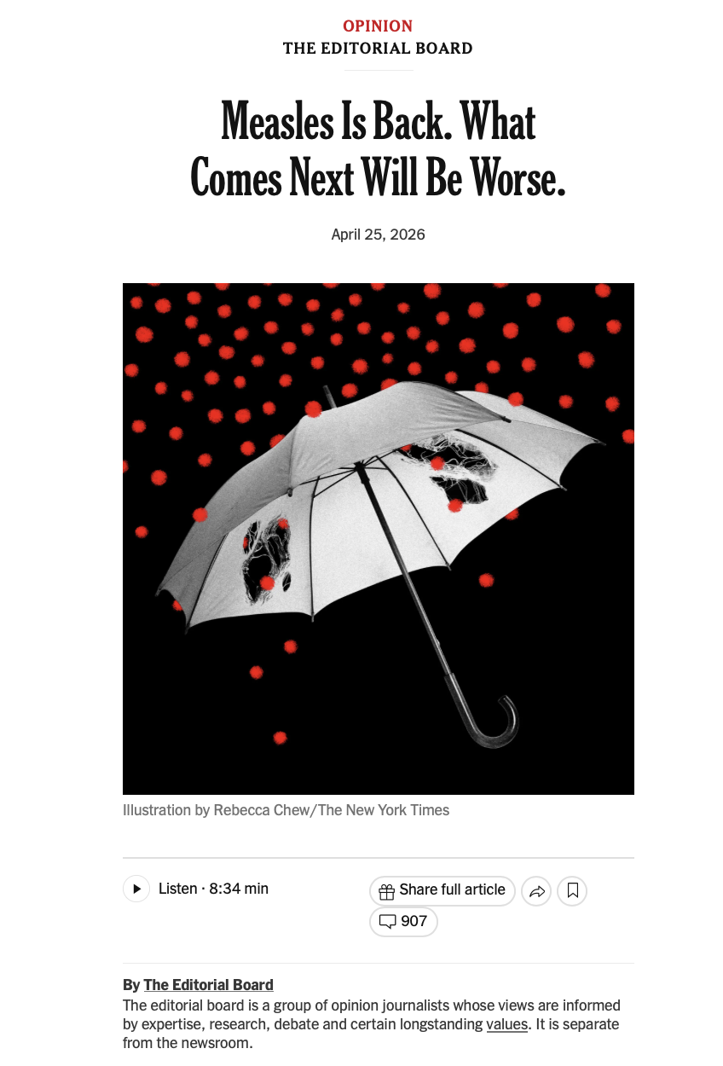

NY Times editorial board

Slide 12
The best op-ed piece convinces you with emotion.
Anger, humor
...and other genuine, relatable feelings.
As well as straight-up facts, information and research….

Slide 13
VERY IMPORTANT
If the reader doesn’t know what you think—and early on—something is DESPERATELY wrong!

Slide 14
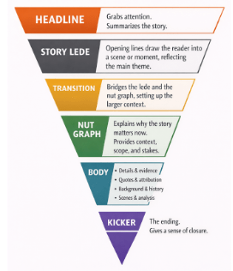
Opinion stories (generally) have same basic feature format

Slide 15
Nut graph:
State the facts of your issue or idea succinctly.
1. Be brief and to the point.
2. Include the news
3. By the end of the nut graph, your opinion should be clear

Slide 16
Next, in the body, elaborate three supporting points. Make sure your paragraphs are short and contain one main idea per paragraph only.

Slide 17

Use facts, statistics and studies to support your arguments. Try not to be boring, preachy or overly technical.

Slide 18

:
No “I” “Me” “My”
So even though this is your opinion, DO NOT (necessarily) write in first person – unless you have a genuine connection to the topic.

Slide 19

Include a “con” to balance out your “pros.” In other words, concede a point to the other side. Otherwise, you sound like a smug a-hole.

Slide 20
Conclude with a paragraph that draws the piece together. At best, a call to action.

Slide 21
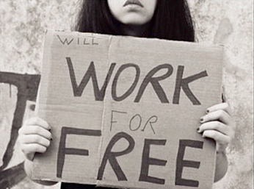
Unpaid Internships – Pro or Con?
To start, think of a topic

Slide 22
News angle for internships
Earlier this fall, the National Association of Colleges and Employers took a firm stance against unpaid internships, arguing in a new campaign—called ”Unpaid Is Unfair”-- that students working without pay should be outlawed nationally.

Slide 23
For (pro) —good opportunity:
Unpaid internships provide hands-on experience that a student normally would not be able to get. Working with seasoned professionals in a real-world setting, can be an invaluable opportunity.
Working for free as an intern offers a short-term investment that can pay off big time after graduation. It’s a foot in the door. Many companies say that once they get to know a student, they are more likely to hire him or her after graduation.
By law, students receive academic credit instead of money. So they do receive “payment;” it’s just not in dollars.

Slide 24
Against (con) —unfair:
In most cases, colleges offer academic credits for internships. However, those credits aren’t free; students still must pay for them in the form of tuition. According to the Education Data Initiative, the average public, four-year university charges in-state residents $390 per credit hour. Most college courses add up to three credit hours, meaning one college class typically costs $1,170. In no universe is paying for the opportunity to work actually fair.
Unpaid internships stoke inequality; research has found that all college students are not equitably represented in internships. Women, Black, Latinx, and first-generation students are underrepresented in paid internships. This trend exacerbates well-evidenced inequities in employment and wealth that poison American society.
Working without pay adds to the country’s student debt crisis. An estimated 43.6 million Americans owe a total of $1.76 trillion in student debt. This adds up to about $37,000 per borrower.

