Slide 1
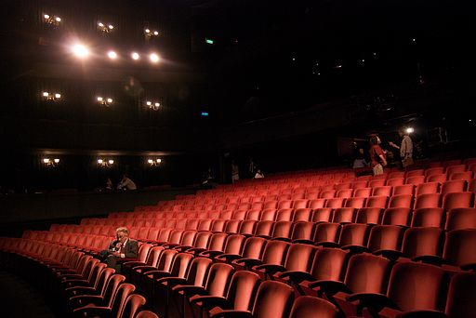
Writing a Movie Review

Slide 2

“In the arts, the critic is the only independent source of information. The rest is advertising.” – Pauline Kael

Slide 3
Some of the best movie reviews are harsh!
Which movie is Pauline Kael talking about?
“The success of a movie like [this one] makes it even more difficult for anyone to try to do anything worth doing, anything relevant to the modern world, anything relevant or expressive. The banks, the studios, the producers will want to give the public what it seems to crave. The more money these “wholesome” movies make, the less wholesome will the state of American movies be.” …
“It’s the big lie. The sugarcoated lie that people seem to want to eat. They even seem to think they should feed it to their kids, that it’s healthful, wonderful “family entertainment.”

Slide 4

Ouch!

Slide 5

Name this movie, trashed in a Pauline Kael review:
This movie is "frenzied hokum," the dialogue was "painfully old-fashioned and mawkish," the dancing was "simpering, sickly romantic ballet," and the "machine-tooled” [lead actress] was so perfectly banal she destroys all thoughts of love.”

Slide 6
