Slide 1

The Feature Story Semester Recap

Slide 2

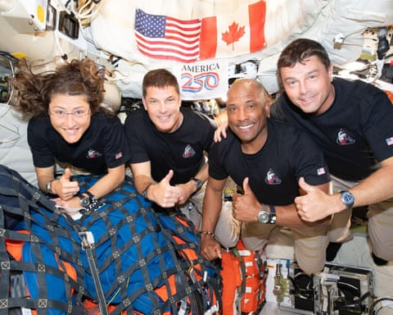
The difference between a news story and a feature story
Congratulations to the Artemis II crew – but the case for sending astronauts into space is rapidly shrinking – The Guardian
Artemis 2 Moon Mission

Slide 3
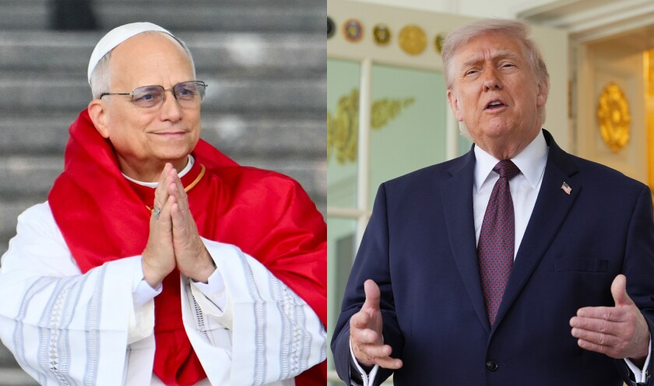
Trump Erupts at Pope Leo

Slide 4
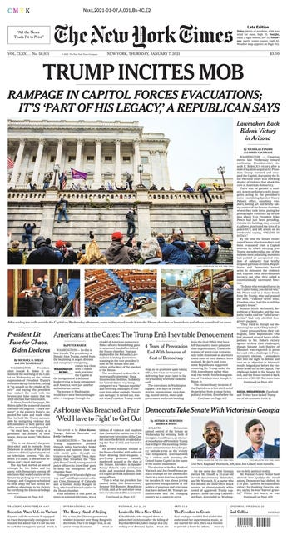
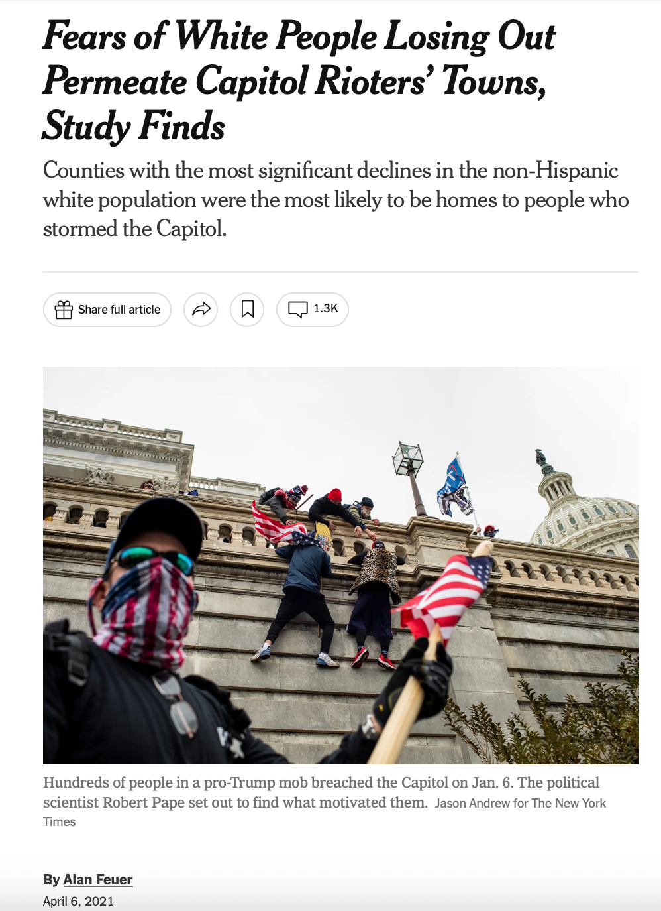
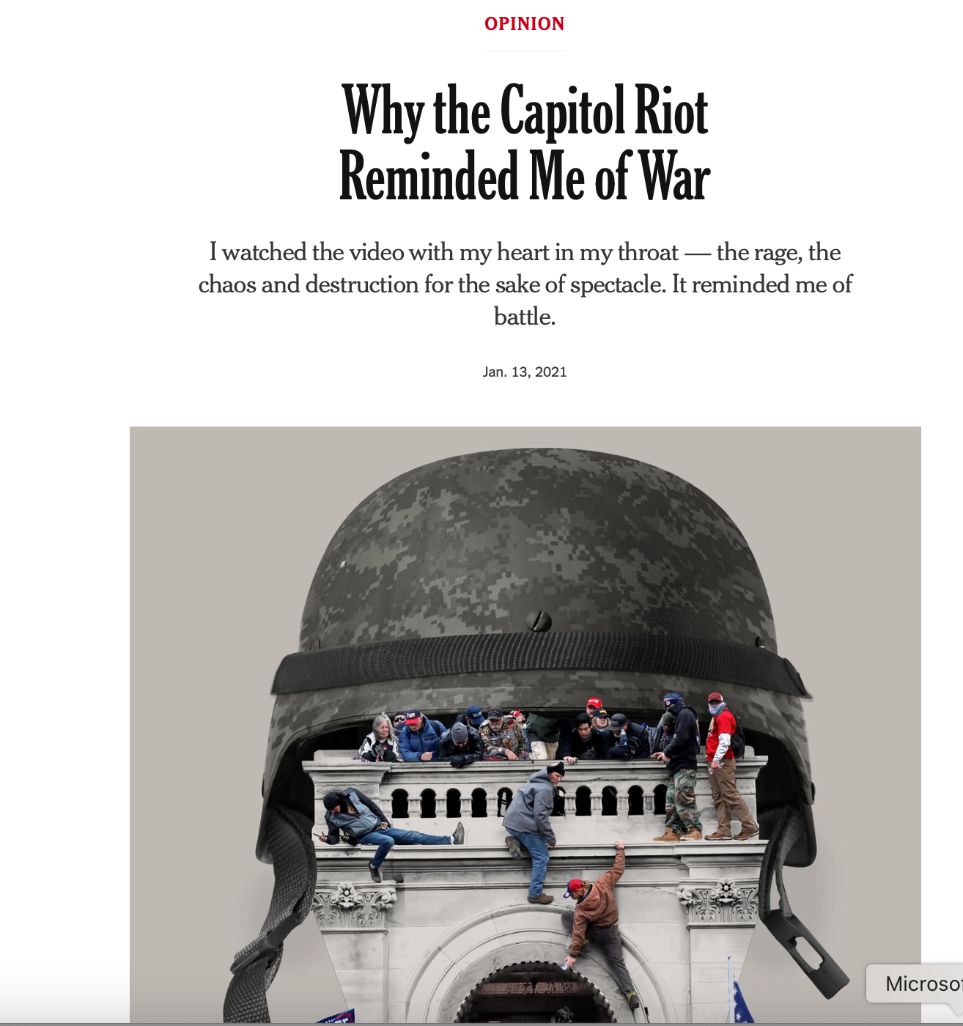

Slide 5
Newsy Feature Stories
A story that follows a news story.
Doesn’t have to be exactly the next day – could be a few days later, weeks, months, years.
Often look at the “why”
It can be a profile, news feature, trend article, op-ed, graphic, etc.

Slide 6
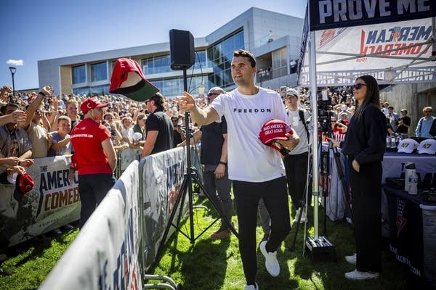
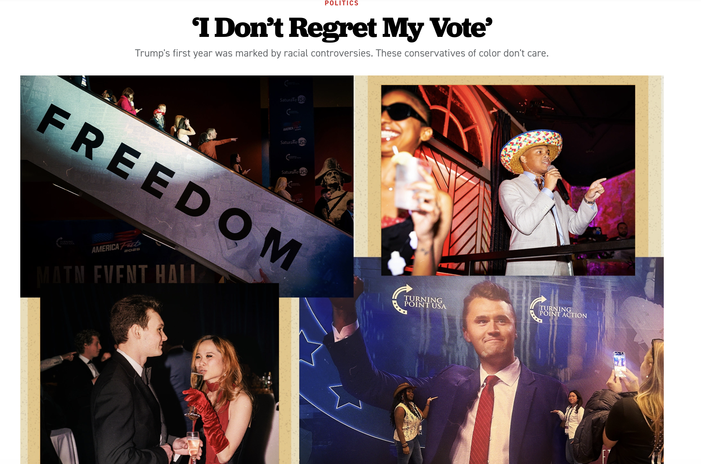
(news) Conservative “activist” Charlie Kirk killed during event in Orem, Utah on September 10, 2025

Slide 7
News vs feature
Though it must have news value, a feature is not rigidly tied to the news.
Takes longer to report and write
Usually touches on a bigger issue than just the obvious.

Slide 8
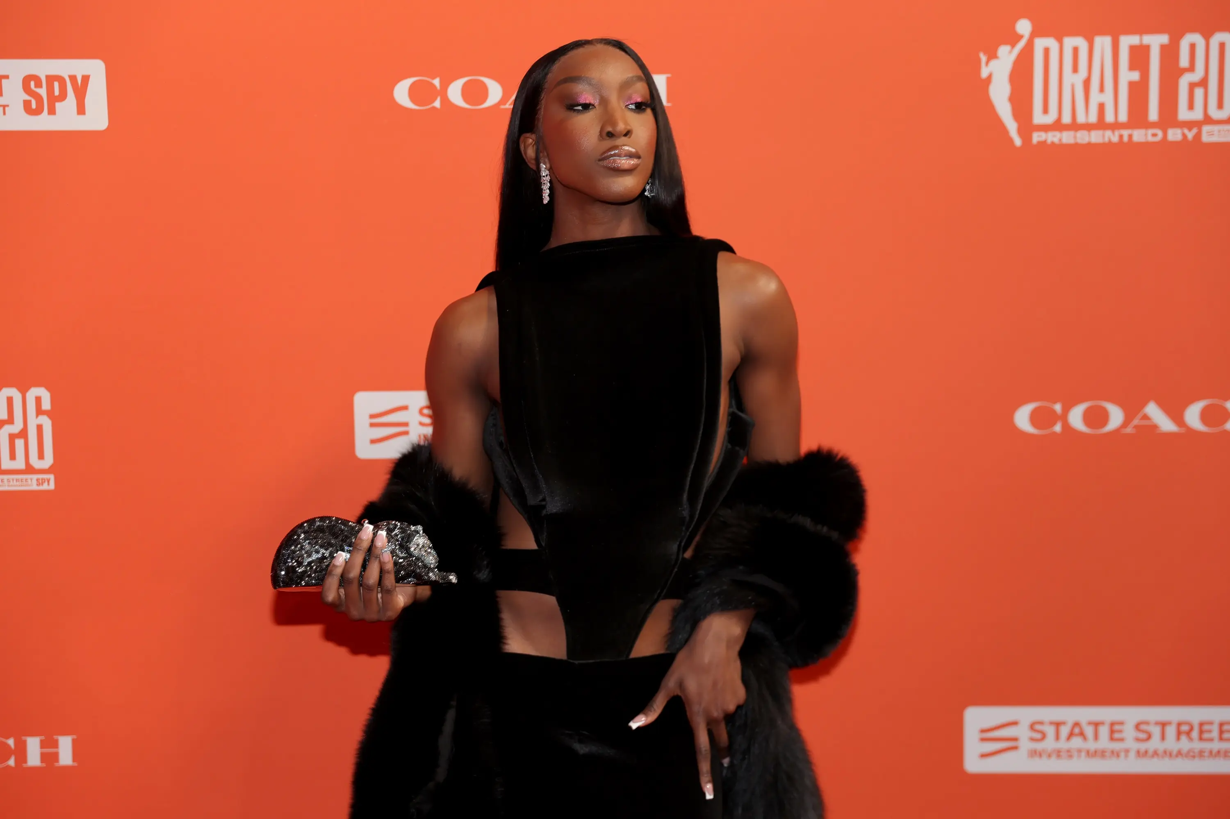
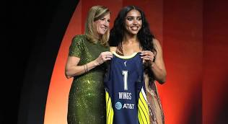
(feature)
Rookies Slay w/ WNBA Orange Carpet Looks
(news) WNBA Draft :
Azzi Fudd goes No 1 in WNBA Draft to Wings, reunites with Paige Bueckers with historic $500K salary

Slide 9
How else is a feature story different from a news story?

Slide 10
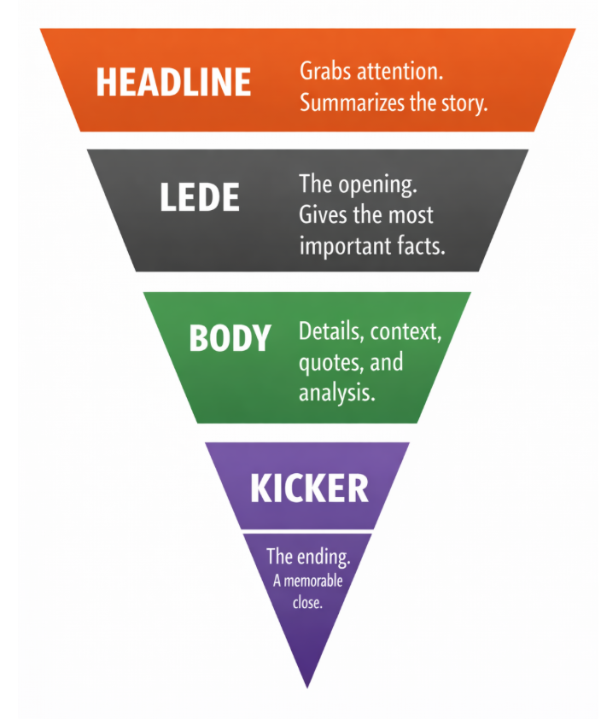
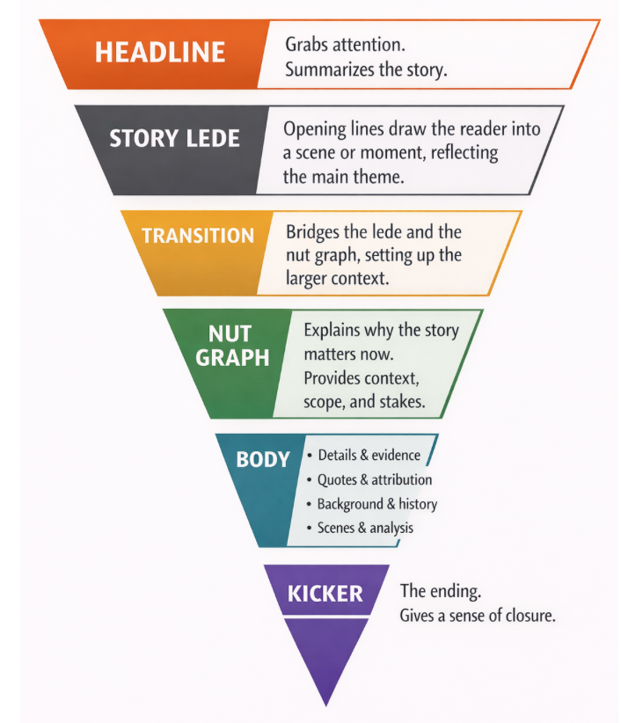
Has a different structure.
The storytelling is generally more creative.
News vs feature story structure

Slide 11
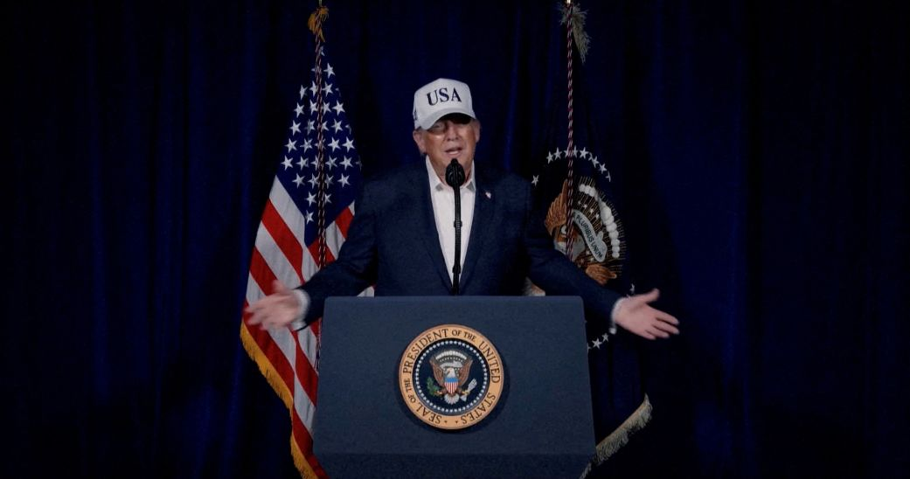
Feature Stories Sound Different
News Story: President Trump spoke to the nation on the war in Iran in a primetime speech from the White House.
Feature Story: A Divided America Processes War with Iran

Slide 12
Feature story ideas: You should have lots of them!

Slide 13
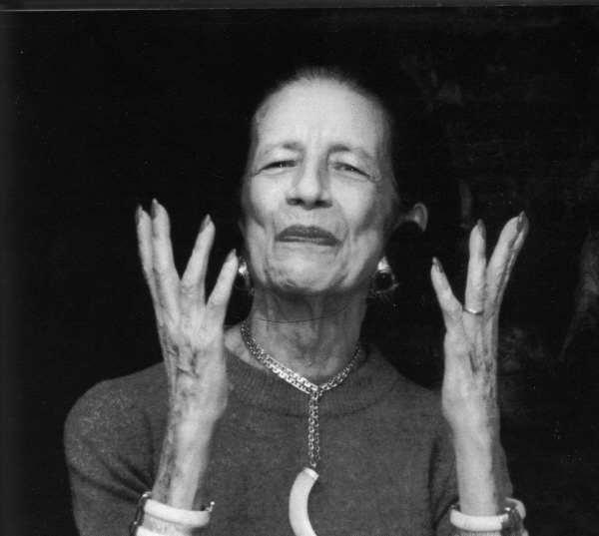
“Give ideas away. Under every idea there's a new idea waiting to be born.” --Diana Vreeland

Slide 14
A good idea:
Must have a news angle/news value.
Must be of interest to your audience

Slide 15
Let’s Keep It Simple...
News
=
What’s New

Slide 16

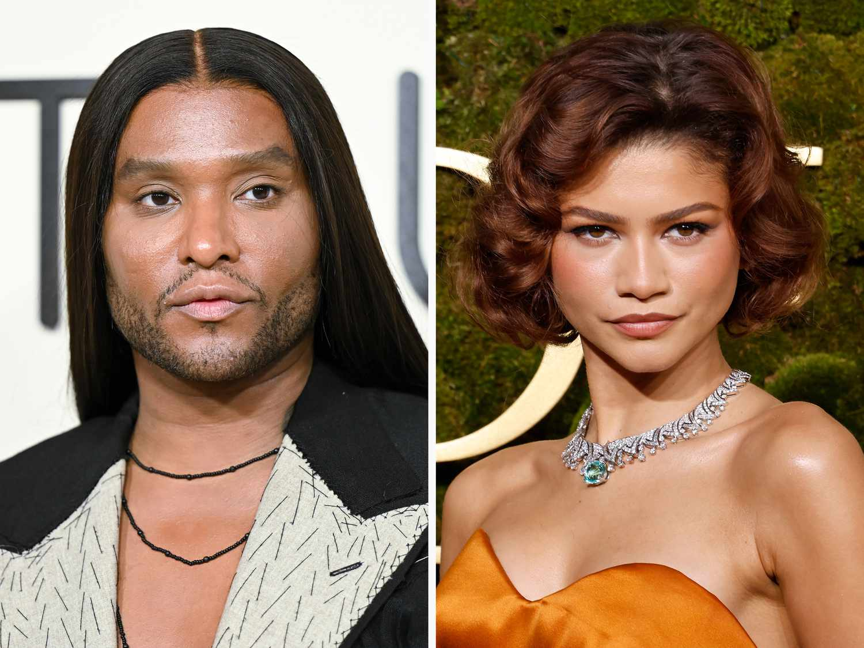
News value the criteria editors, producers and reporters use to decide what news is fit to print or broadcast

Slide 17
For feature story ideas, ask yourself
Why this idea at this time? [AKA: what’s new?]
What does my reader want? Why do my readers/users CARE about this topic? What’s in it for them?

Slide 18
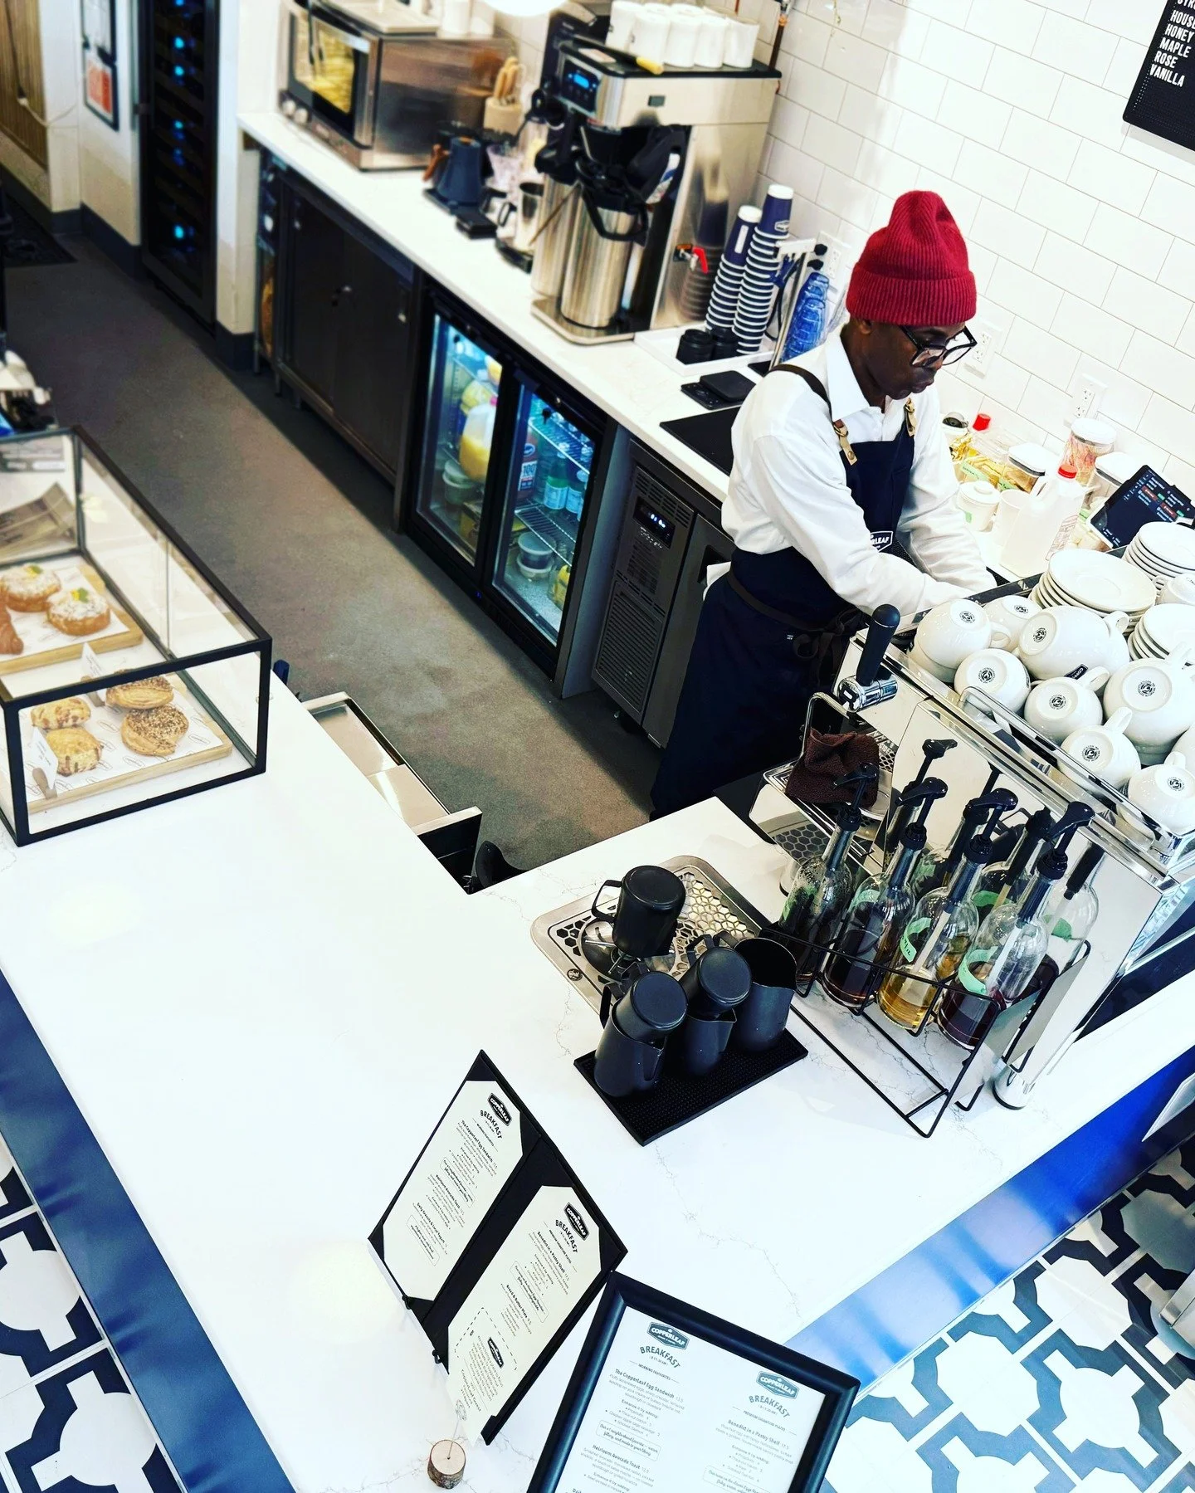
This is news for Harlem, where my mom lives
Copperleaf Bakery opens in Central Harlem
at 2118 Frederick Douglass Blvd between W 114th and W 115th Sts
This stylish new bakery serving breakfast and lunch—there's a spacious seat-yourself area—makes its own croissants and desserts like the ube cheesecake, plus sandwiches, soup and even wine. (thecuriousuptowner.com)

Slide 19
How to add a news angle to your stories. Tie it to:
Something that happened very recently--news
The season
An anniversary
A new study
A trend
An issue students/community residents are buzzing about or that’s really interesting or compelling

Slide 20
How to find ideas:
Read the news—local, national, international. Think of how a current news story might be “spun” for an audience.
Look at newsy websites for news ideas.
Mine your beats – subject or location
Look at community media – tweak or update or offer an original spin.
Keep your ear to the ground. Listen to what other students, family, professors, friends, neighbors are talking about.
Think about how something’s changed.
Consider what’s important to your audience RIGHT NOW.

Slide 21

Trump Portrays Himself as Jesus Christ with AI-Generated Image After Slamming Pope Leo

Slide 22
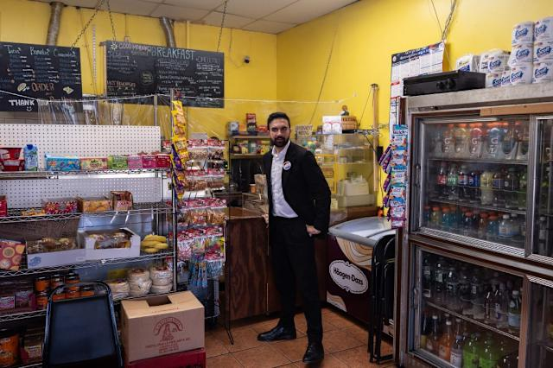
Mamdani unveils plan to open first city-owned grocery store
La Marqueta, a hub for Latin American and Caribbean culture will now also be the site of the five boroughs' first city-owned grocery store.

Slide 23
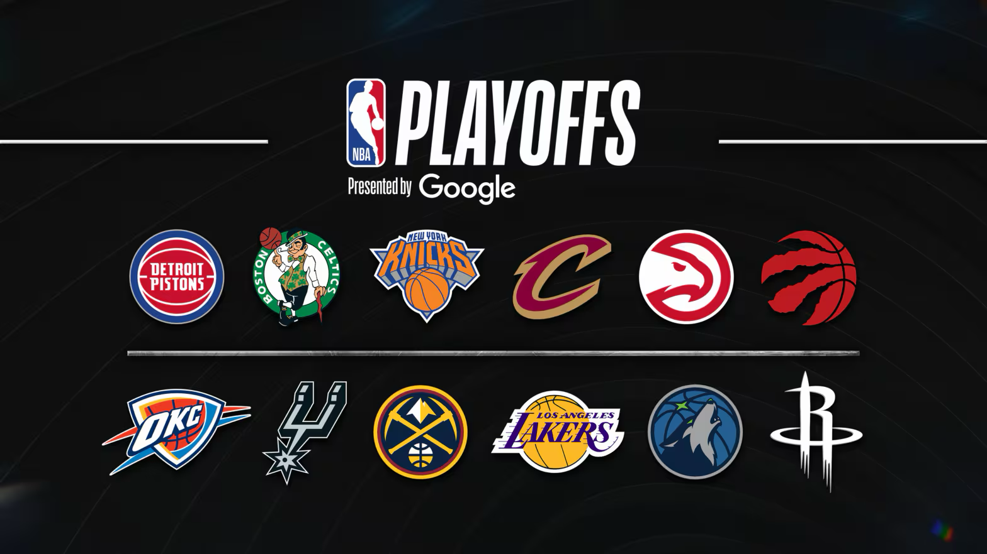
NBA Playoffs Begin this Week

Slide 24
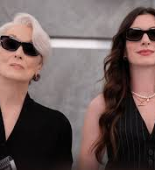
Devil Wears Prada 2:
May 1 Premiere

Slide 25
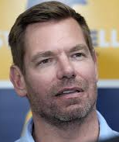

Eric Swalwell suspends governor campaign amid sexual misconduct allegations

Slide 26
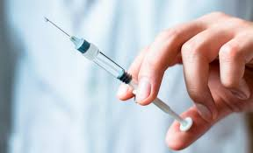
New research: More Americans doubt vaccine safety than trust it, POLITICO Poll finds

Slide 27

Anniversary: Coachella Celebrates 25 Years

Slide 28

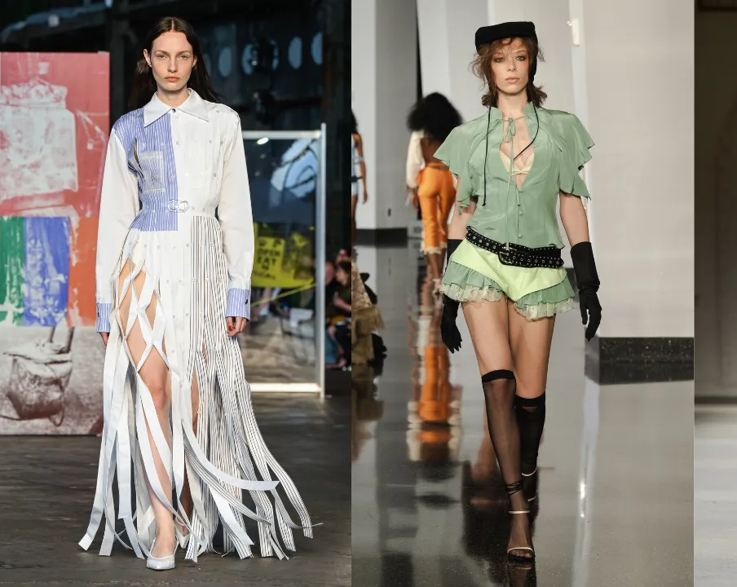
Seasonal

Slide 29

Find a new angle on an ongoing or evergreen story

