Slide 1
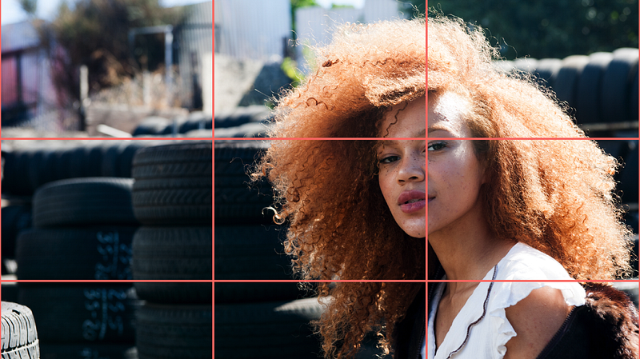
Know the rule of thirds when taking photographs

Slide 2
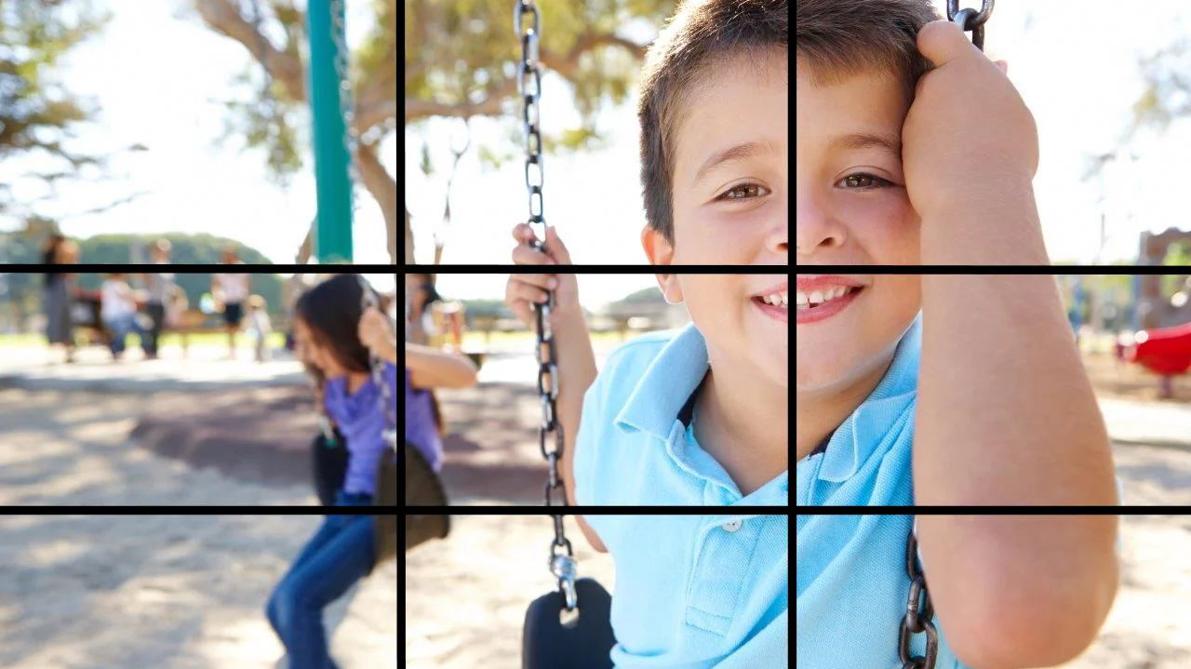
The rule of thirds is a photo composition guideline that places your subject in the left or right third of an image (not in the middle), leaving the other two thirds more open.

Slide 3
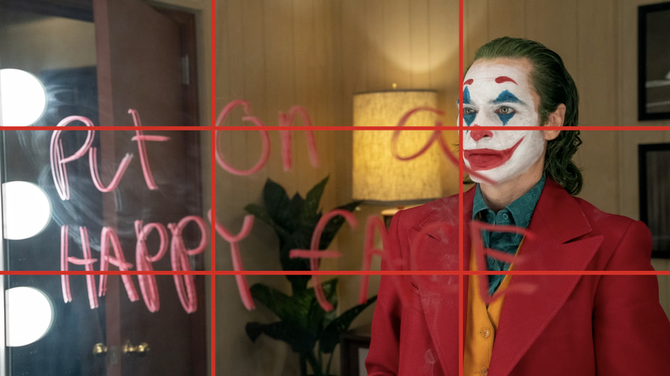
Cinematographers follow the rule of thirds

Slide 4
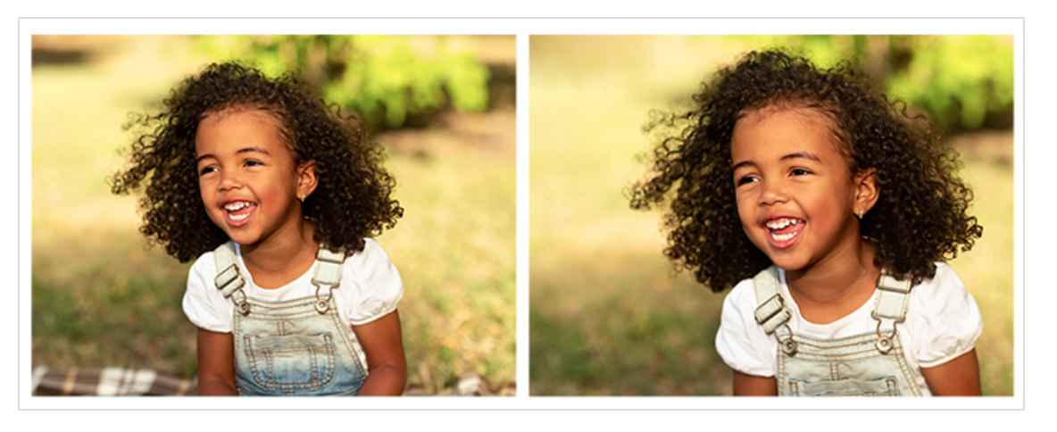
Very minor difference of super cute little girl – but one on the right is more energetic

Slide 5
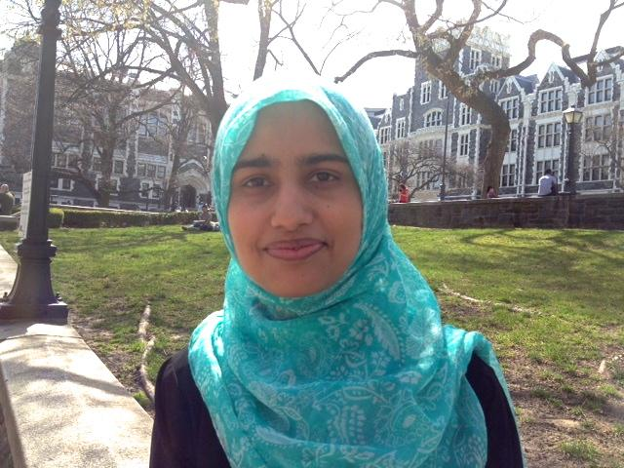
This is a pic I took of my former student. See how she’s plopped in the middle of the frame? (wrong)

Slide 6
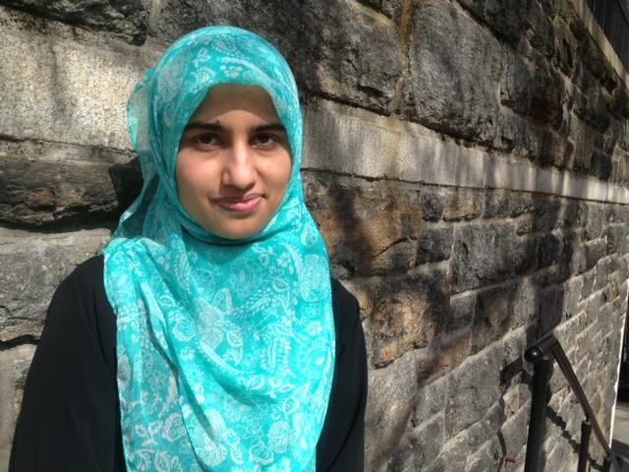
This is my re-take. I followed the rule of thirds. See how much better this photo is. It offers more “perspective.”

Slide 7

Same here – plopped in middle of frame

Slide 8

Better shot, right?

Slide 9
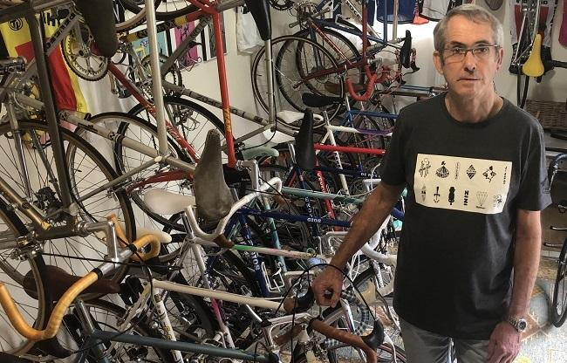
The rule of thirds allows you to add context to your subjects (show, don’t only tell) – look at this bike collector

Slide 10
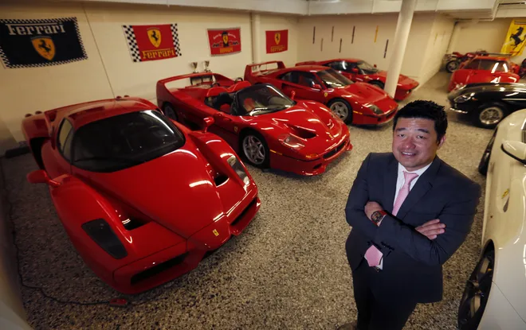
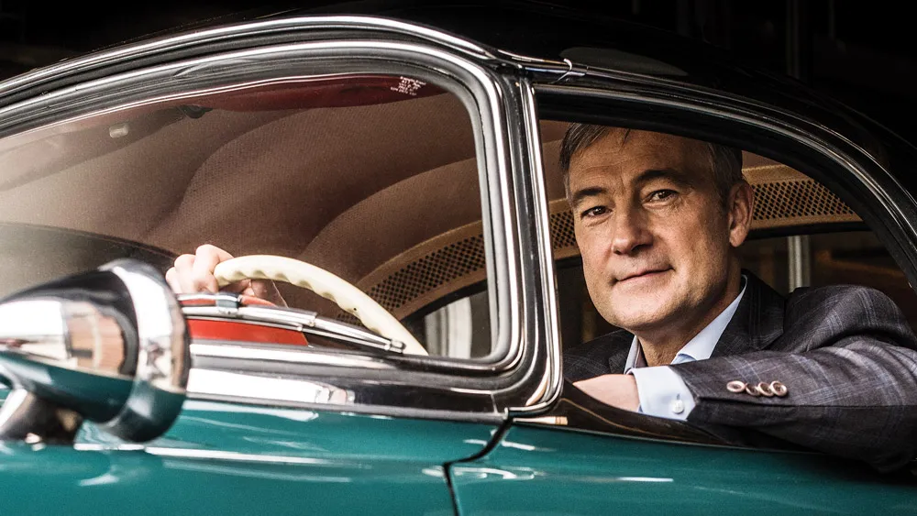
Two different shots – both good perspectives

Slide 11

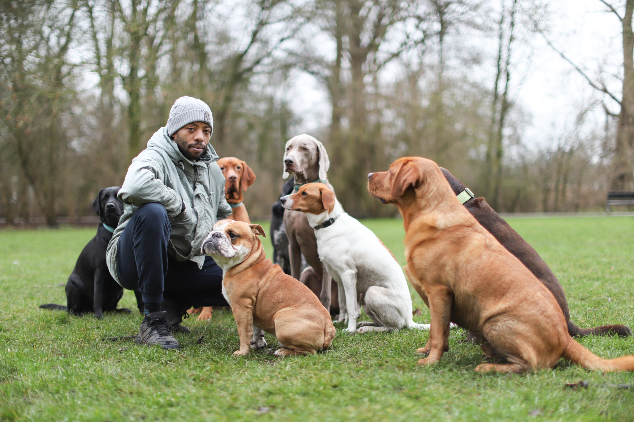
Let the photo help you tell your story

Slide 12
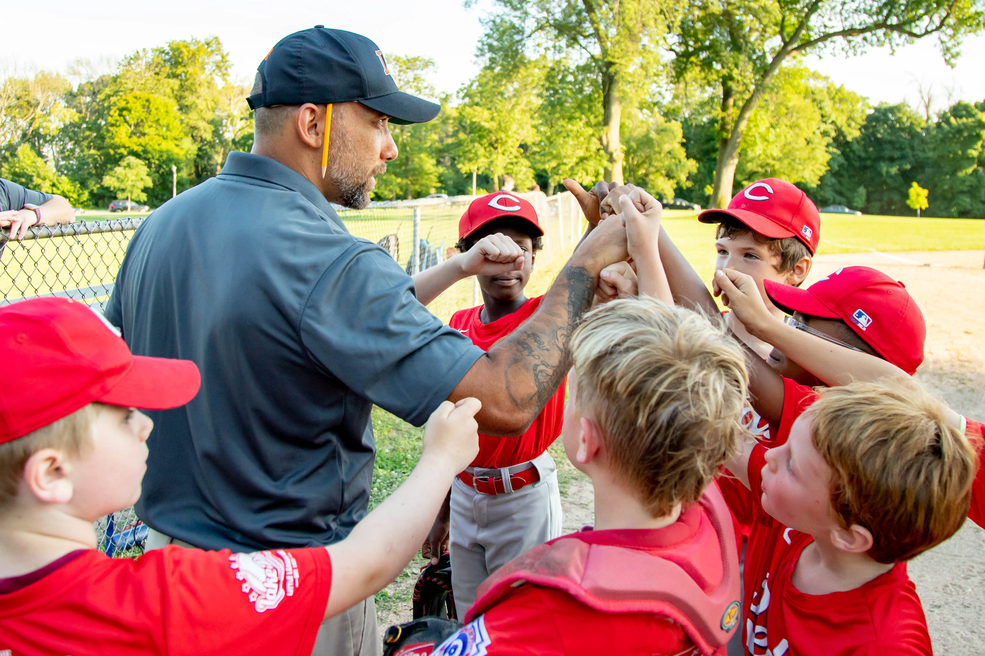

You don’t have to have eye contact – action’s good

Slide 13


It’s also okay to be on the nose

Slide 14
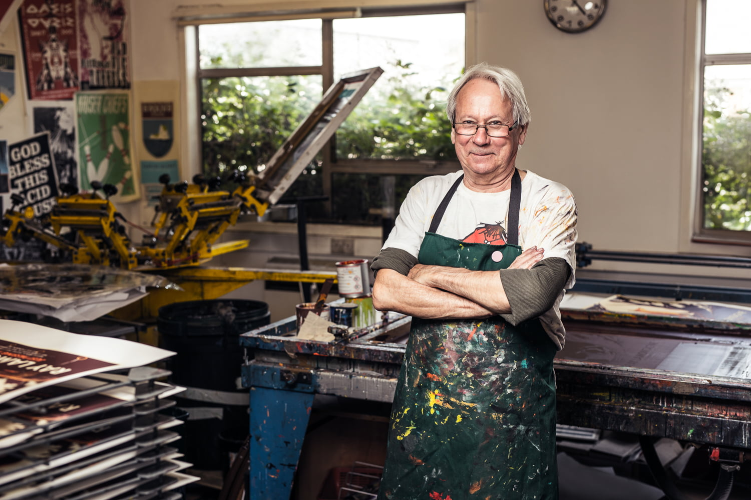
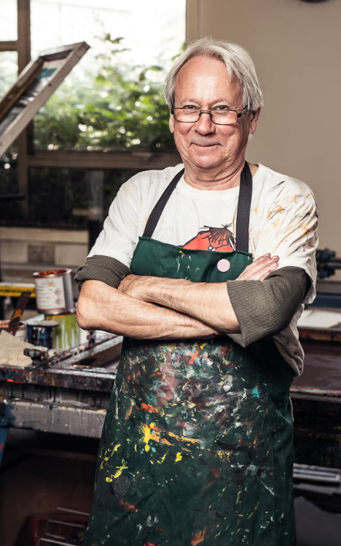
Be sure to take HORIZONTAL not Vertical photo
Not this

