Slide 1

How to conduct an interview

Slide 2
Prepare thoroughly before the interview
The more you know, the easier the interview will be.
If you know some of the basic facts--age (birthdate), home country, title--you can skip to the good stuff.
The more you know, the easier it’ll be to figure out if someone’s lying to you!

Slide 3
Come up with some questions beforehand.
But don’t read them. You’ll sound like an amateur.
Go with the flow, your curiosity and your gut.

Slide 4
Be fearless
Most people want to talk.
Don’t be afraid to ask something that you really want to know about. The person can refuse to answer.
Save the tough questions for the end…in case your subject hangs up or walks out!

Slide 5
Sometimes the best question is the follow-up:
Why?
Tell me more
Can you explain?

Slide 6
Focus on one issue at a time.
Vague, complicated questions, produce vague, complicated answers.
So stay away from: “I’d like to start with a three-part question…Part 1….

Slide 7
Keep the questions short.
Don’t talk too much. Listen instead.
Keep the focus on the subject.
Listen actively and attentively.

Slide 8
But not too short!
If you ask a “yes or no” question, you’ll get a “yes or no” answer.
So instead of: “did you see what happened?” Try: “Describe what happened.”
Not: “did you have a happy childhood?” Try: “tell me about your childhood.”

Slide 9
Listen carefully and write down (or record) quotes accurately.

Slide 10
An interview isn’t just about asking questions.
Observe the person, the environment, the scene.

Slide 11
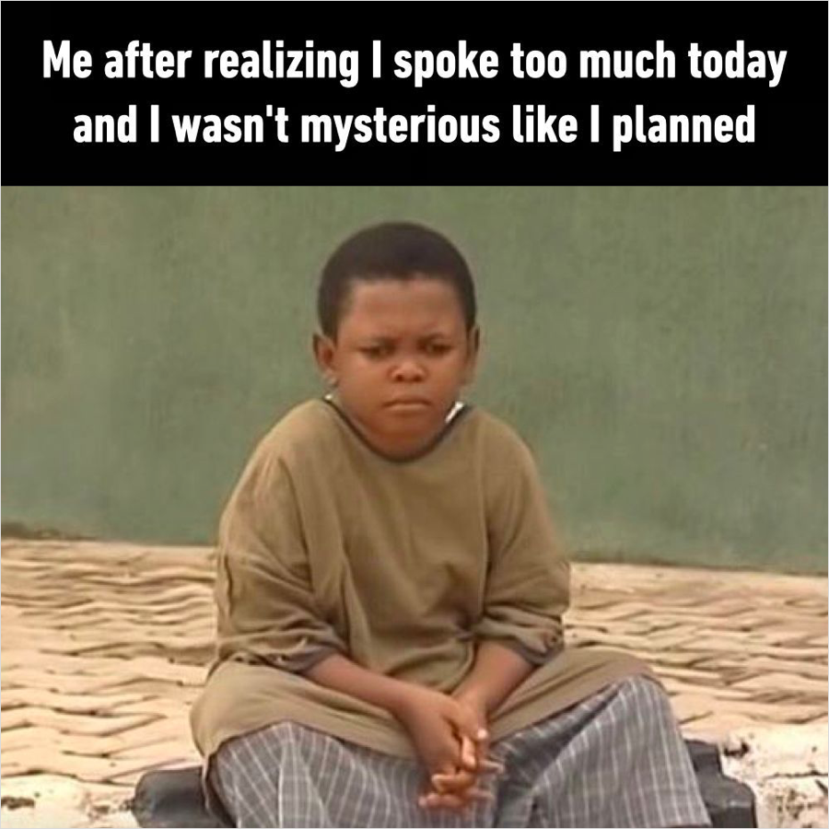
It’s okay to talk about yourself – but not too much!

Slide 12
Stay focused.
1. The best profiles have a theme or “spin.”
2. Make sure your questions are in line with however you’ve decided to frame your piece. Think about what the reader wants to know.
3. Get lots of details by asking detailed questions.

Slide 13
At the end, ask the subject:
Did I miss anything?
Would you like to add anything else?
Is there any question I should’ve asked but didn’t?

