Slide 1
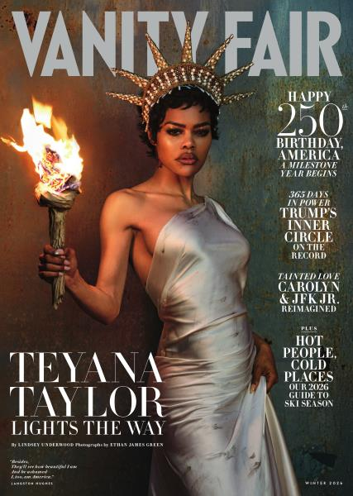
Writing about people

Slide 2
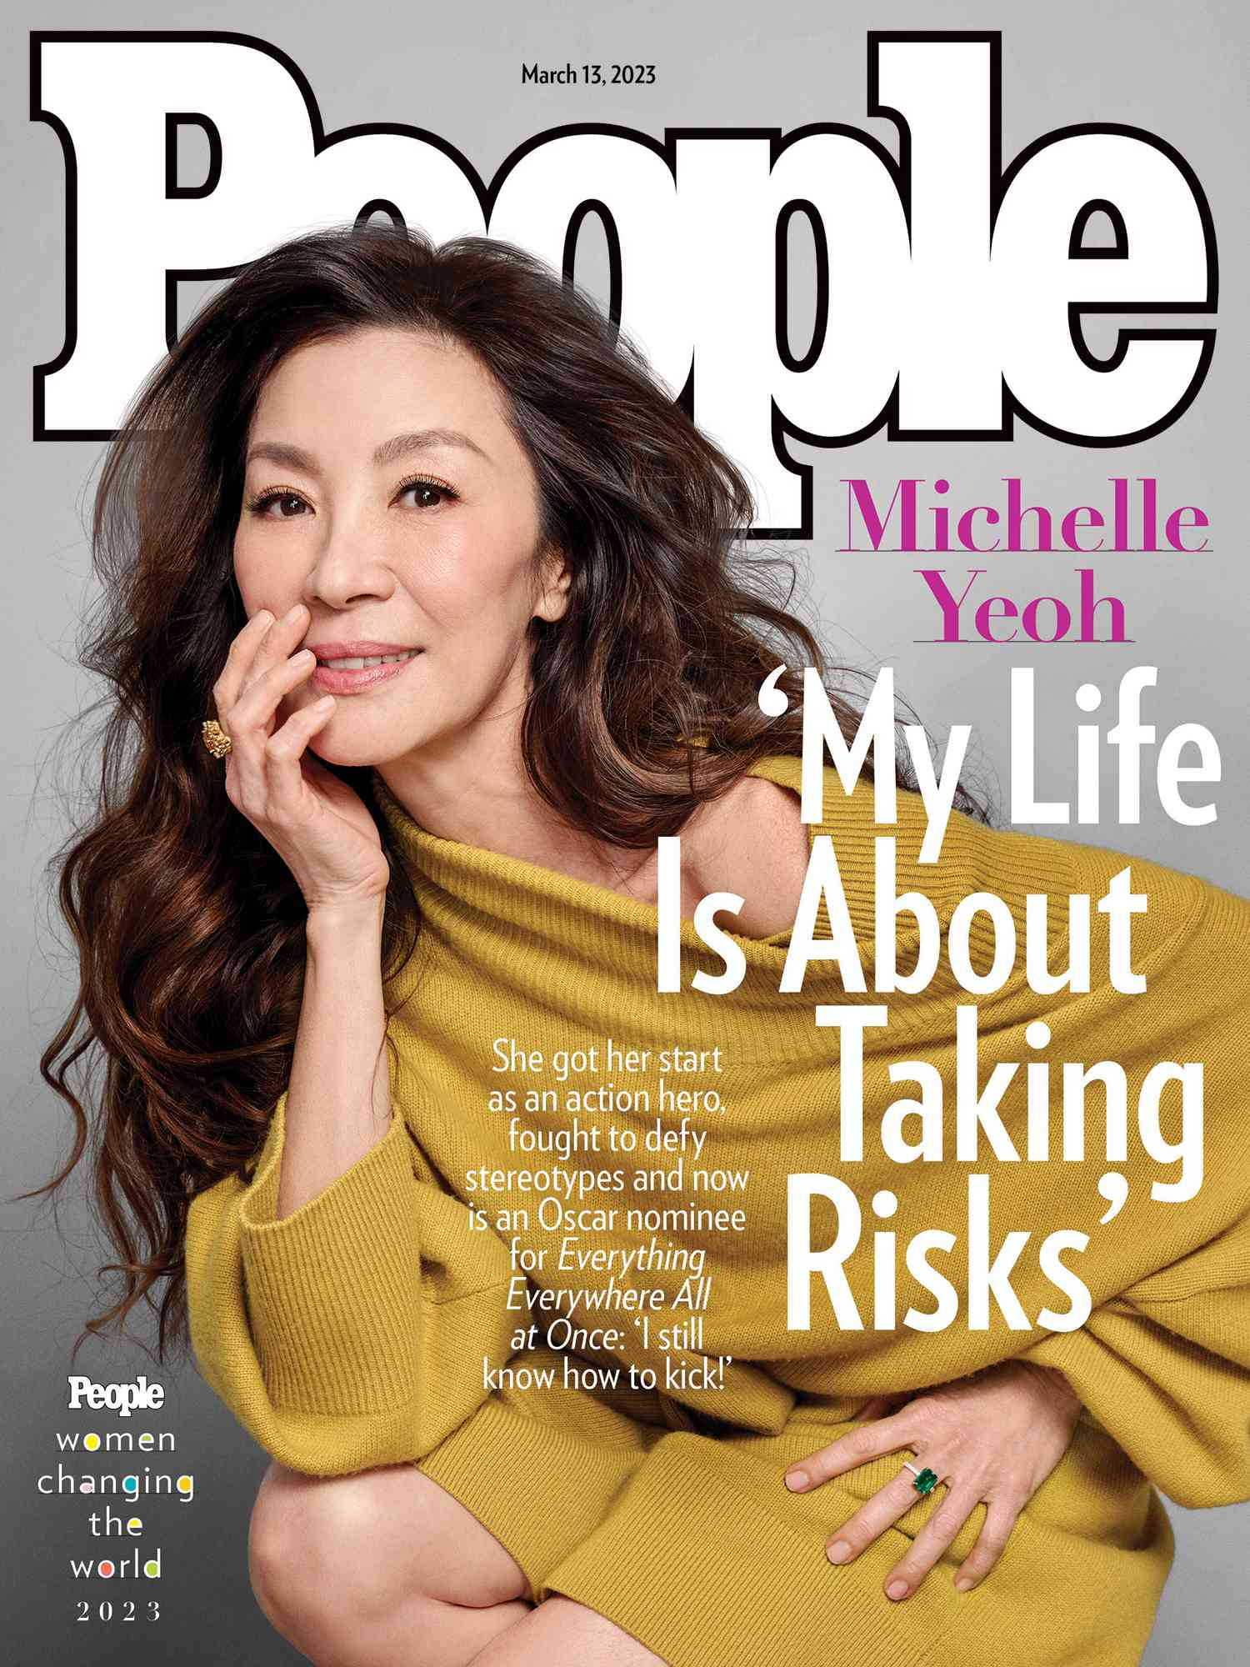

A profile is: a feature story about a person
1,500 × 2,000

Slide 3
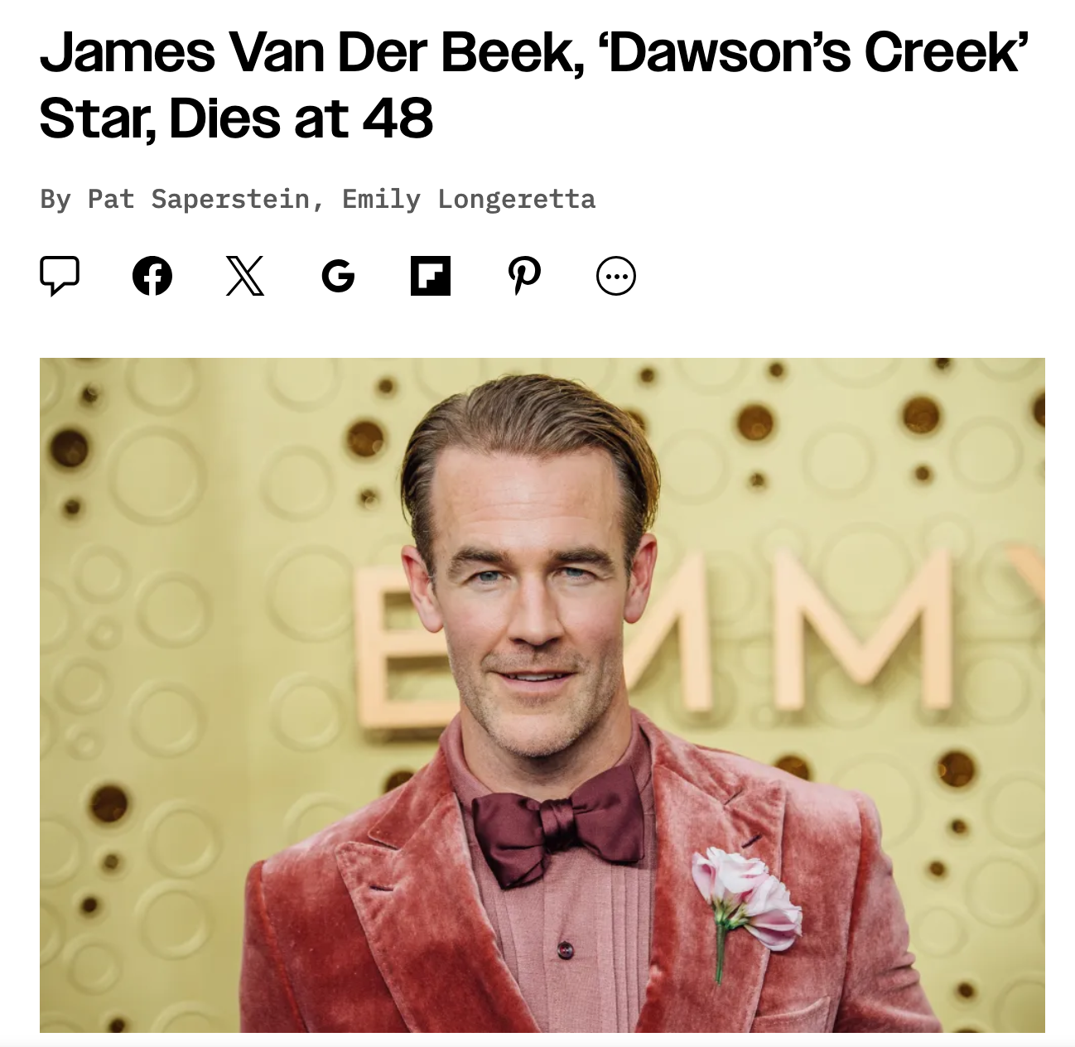
An obituary: a profile of someone who has died

Slide 4
The best profiles….
Have a news or newsy angle
Have nut graphs…though you might not notice them.
Are about something. Don’t write someone’s biography.
And…by the end, the reader should feel like we know the person better.

Slide 5

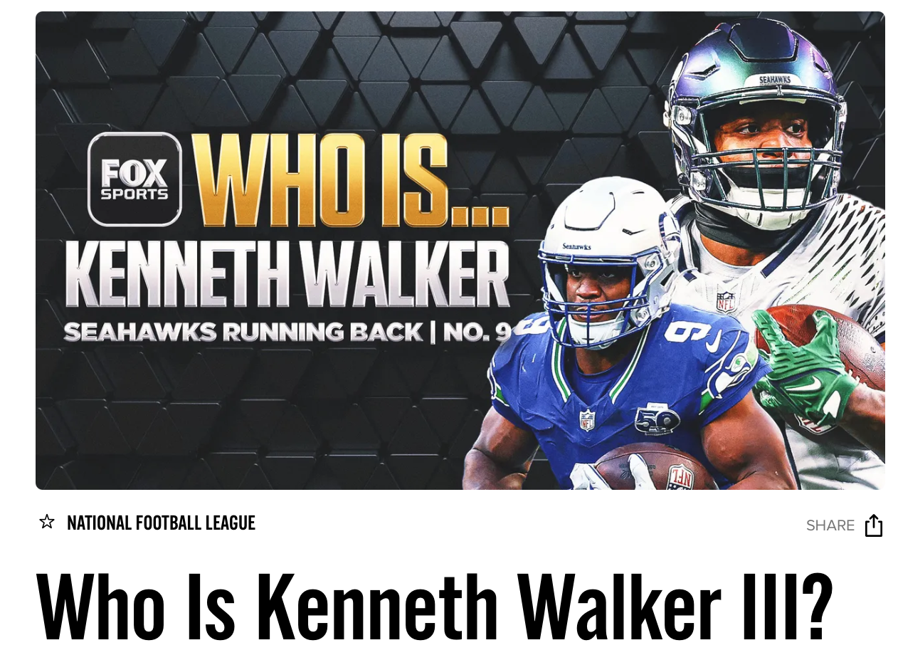
Journalistic profiles always have a news angle

Slide 6
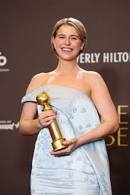
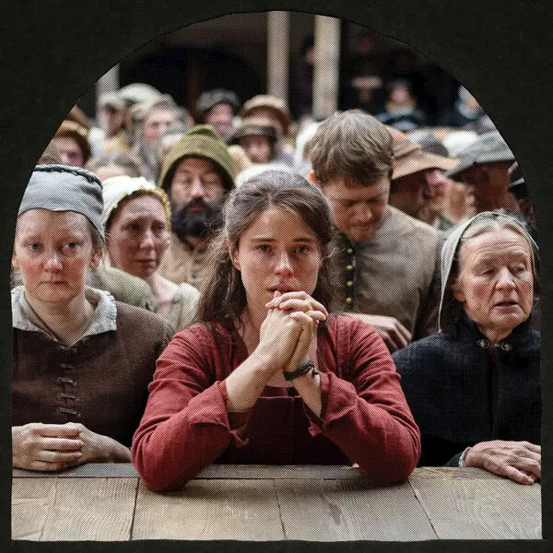
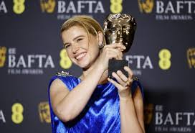
Jessie Buckley,
learly newsworthy

Slide 7
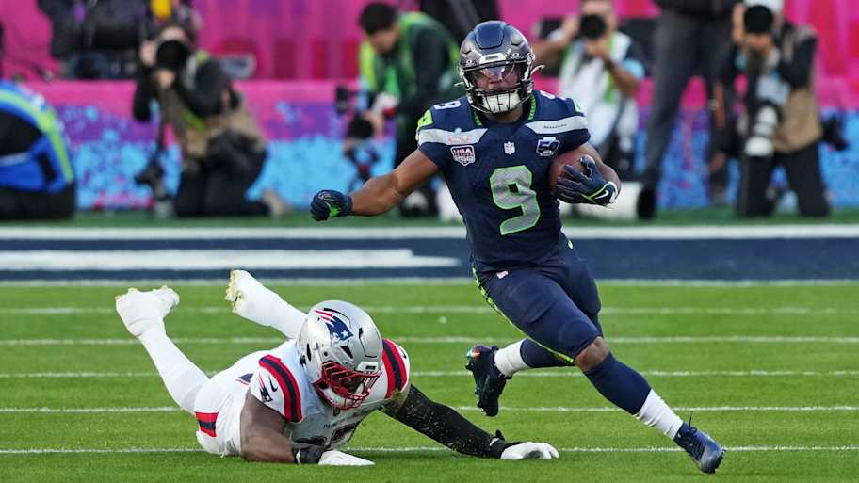
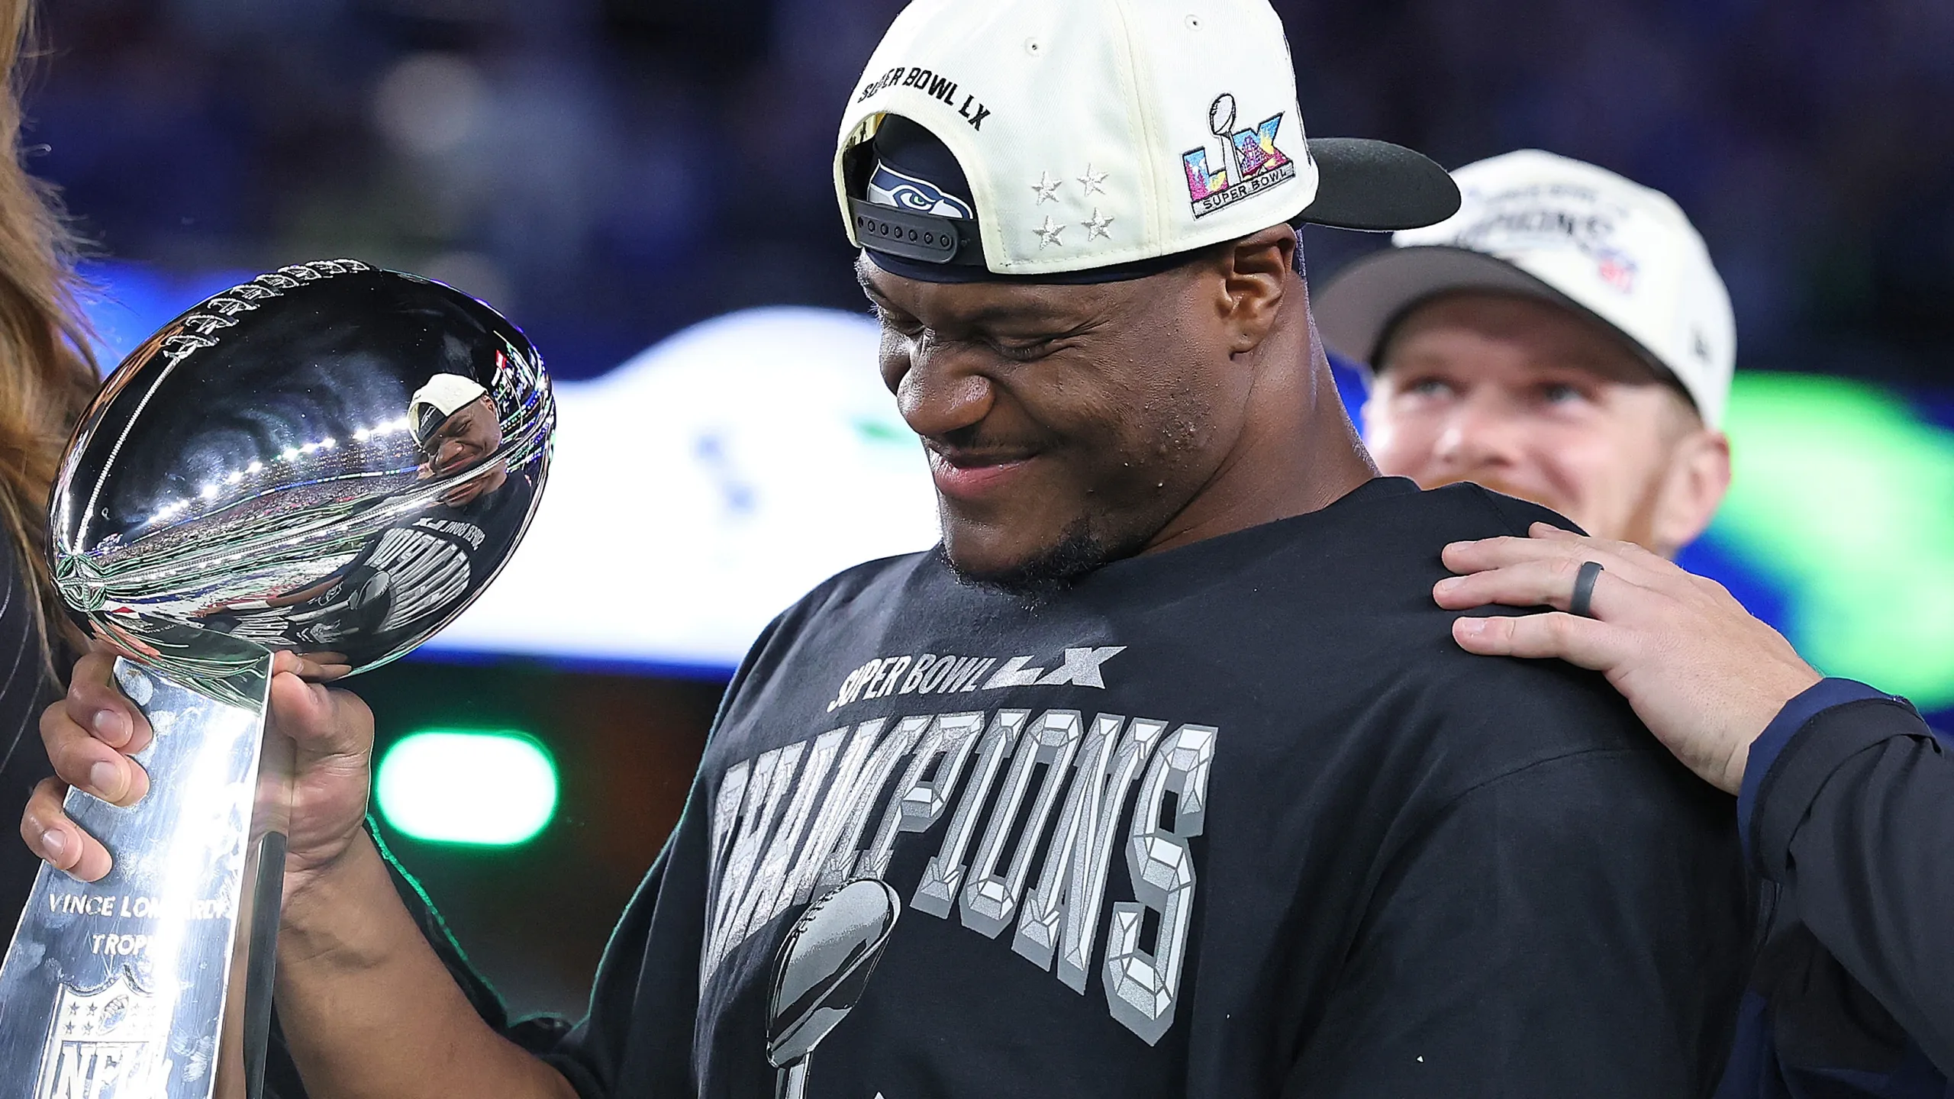
Kenneth Walker, III, newsworthy

Slide 8

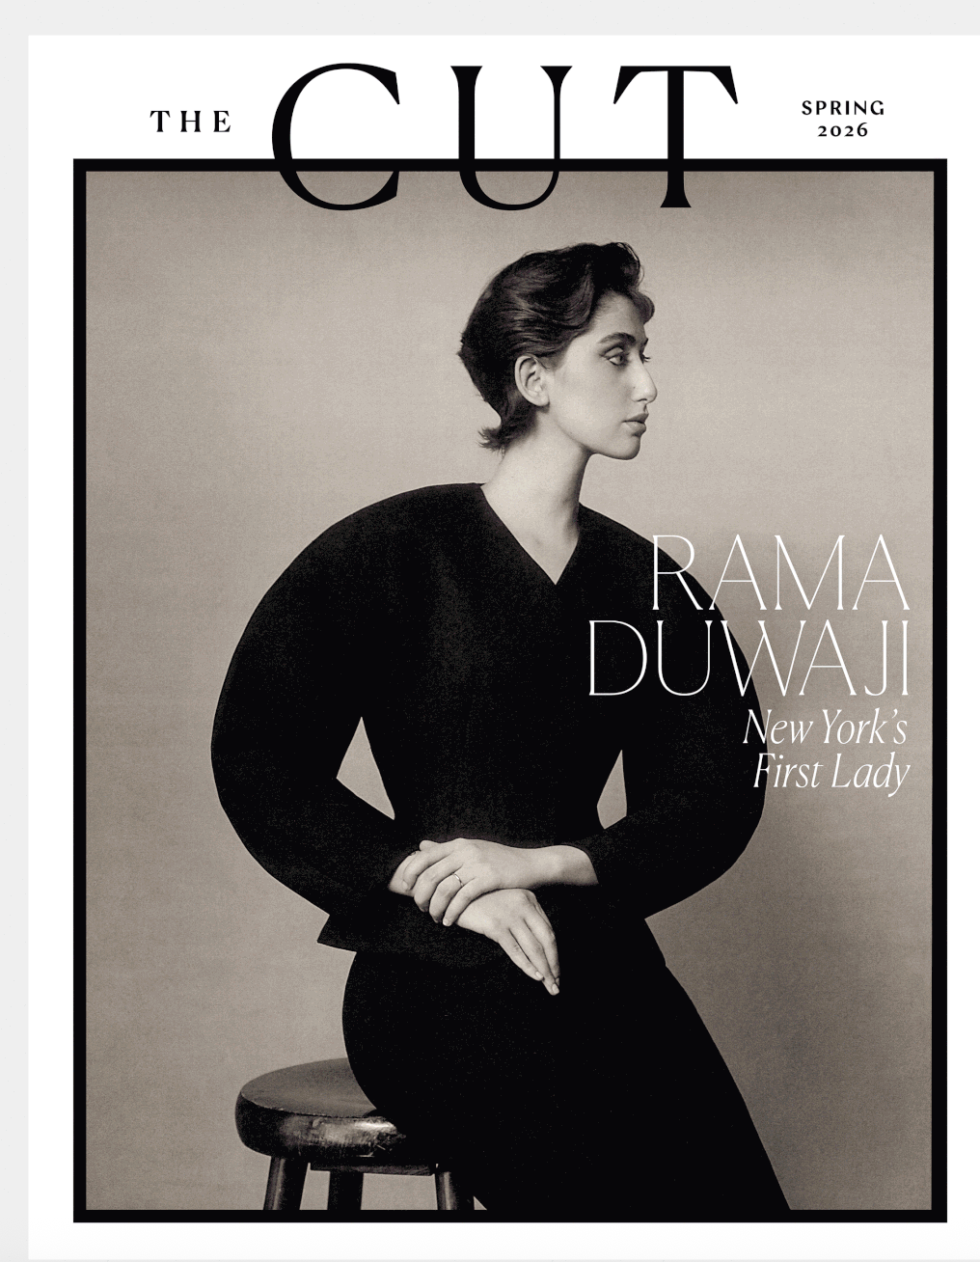
Why profile newsworthy people and put them on magazine covers?

Slide 9


The economics of magazines
Subscription: $12 for 6 issues
Subscription: $84 for 48 issues
Newsstand: About $10.99 per issue
Newsstand: $8.49 per issue or $407.52 a year
(Need to sell only 10 issues on newsstand to = sub price)

Slide 10
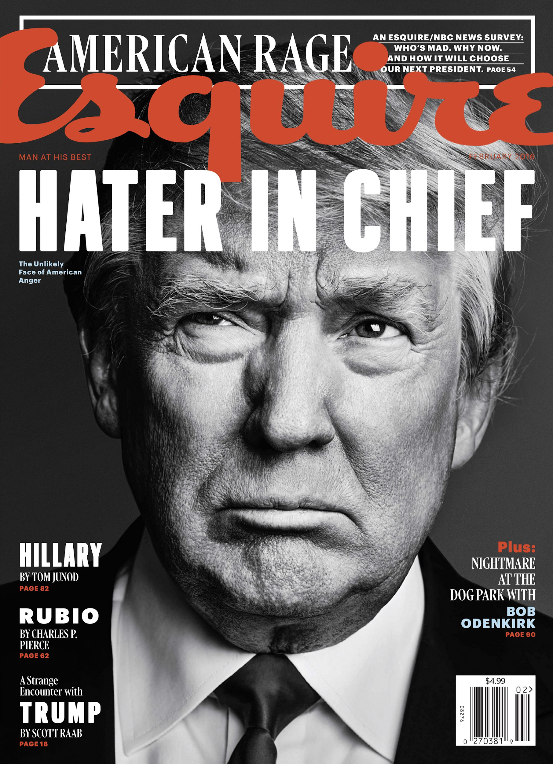
Best profiles have a spin

Slide 11
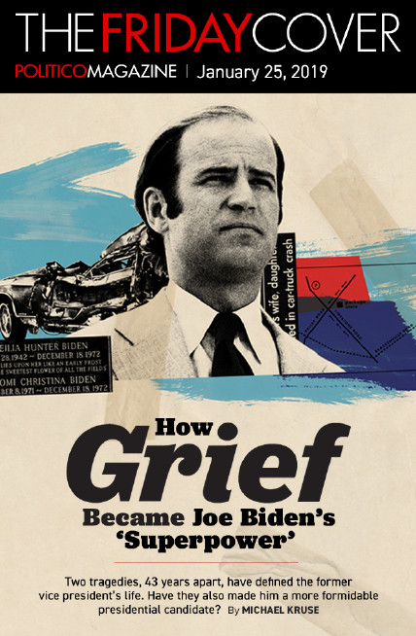
Profiles are about someone and about something

Slide 12
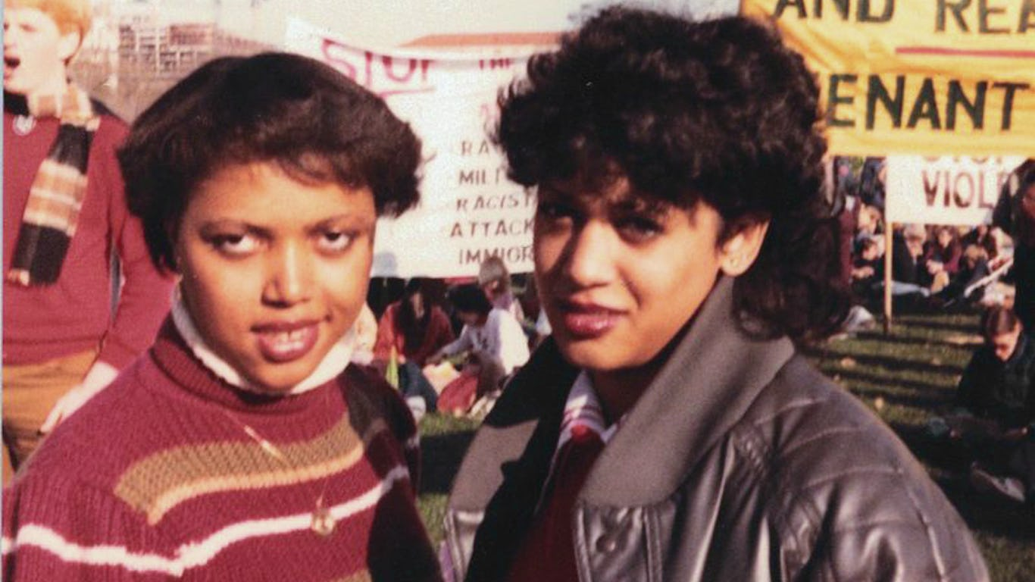
Is Kamala Harris Black Enough?
By Robin Givhan, Washington Post SEPTEMBER 16, 2019

Slide 13


Slide 14
Profile Writing Guidelines
Your story must be about someone and also about something.
Make the reader understand why we should care about the person, why he/she/they are interesting.
Allow your subject to speak for him/herself/themself.

Slide 15
Interview a person in person, take a photo, write a profile
Headline: Who is the person and why are they interesting
Story lede: Write an anecdotal or narrative lede for this kind of piece.
Nut graph: what the story is about. In other words, why is this person significant? Why should we care about him/her/them? What’s interesting? What’s new?
Body: Discuss the person, use direct quotes from them – include one quote from someone else about the person
Don’t write in first person – you can edit the quotes down Ending/kicker: Finish big w/ a great quote or nice wrap-up.

