Slide 1

Editing

Slide 2

An editor’s job: to improve the writing and be the writer’s best friend, ride-or-die.

Slide 3

This includes you – as you will often be self editing.

Slide 4
What you should look for:
Structure
Clarity
Grammar and punctuation
As you read, ask: Is this story, and every word and sentence, the best it can be?

Slide 5
Critique with kindness but honesty.
Writing’s hard. Start with something positive.

Slide 6
Make sure the story has:
A headline
All the facts – who, what, when, where and why in the nut graph
Direct quotes, punctuated correctly. “My film takes a look at caregivers,” says Professor Deirdre Fishel. “It honors their hard work.”
No first name of subject (except first mention) and absolutely NO FIRST PERSON.
Has a kicker or ending. (Doesn’t just stop or trail off.)
Has no grammatical errors.

Slide 7
Are your paragraphs too long? In general each should have just one point, supported by a quote or stat
Students at CUNY colleges generally commute an hour each way. Many don’t like it. “I get so sleepy on the train,” says Alex Gomez, a Lehman College junior, majoring in English. “I wish I had found a college in Queens instead of the Bronx.”

Slide 8
Break up quotes into two parts:
Not: “I love coffee. It helps me wake up in the morning, and I can hardly get through the day without it,” says Cynthia Reyes, 22.
Better: “I love coffee,” says Cynthia Reyes, 22. “I can hardly get through the day without it.”

Slide 9
Include links
Many New Yorkers reacted to former Mayor Eric Adams’s comments about his indictment.
Some believe Spanish should be mandatory for faculty members because of the large number of Latino students at CUNY.

Slide 10
Pay attention to grammar
Avoid….
Passive voice (uck)
Not: Passive voice should be avoided by journalism students.
Better: Journalism students should avoid passive voice.
Long complicated sentences (you know what these are – simplify)

Slide 11
Avoid:
Repetition of words and phrases
Not: He decided to stop by the grocery store to pick up some cereal. Remembering he had an overdue book, he also stopped by the library.
Better: He decided to stop by the grocery store to pick up some cereal. Remembering he had an overdue book, he also went to the library.

Slide 12
Vary types of sentences
Not: He stayed up late studying for midterm exams. He didn’t fall asleep until sunrise. He felt like crap the next day.
Better: He stayed up late studying for midterm exams, finally falling asleep at sunrise. The next day he felt like crap.

Slide 13
Avoid:
Unnecessary words/phrases
Not: Tuesday morning subway service slowed to a crawl, due to the fact it had snowed all night.
Cleaner: Overnight snowfall caused Tuesday morning subway service to slow to a crawl.
Not: She only watched SNL in order to see JLo.
Better: She only watched SNL to see JLo.

Slide 14
Cut down on
The “to be” verb as best you can (is, are, were). Use active verbs instead.
Not: The election of Zohran Mamdani as mayor was the introduction of a new era.
Better: The election of Zohran Mamdani as mayor introduced/kicked off/marked the beginning of a new era.
Not: The reason this made him sneeze was because he was allergic to pollen.
Better: An allergy to pollen made him sneeze.

Slide 15
Avoid
All forms of there is/there are/there were
Not: There are parents who don’t believe in vaccinating their kids.
Better: Some parents don’t believe in vaccinating their kids.
Not: There are many dangers skiers face every day.
Better: Skiers face many dangers every day.

Slide 16
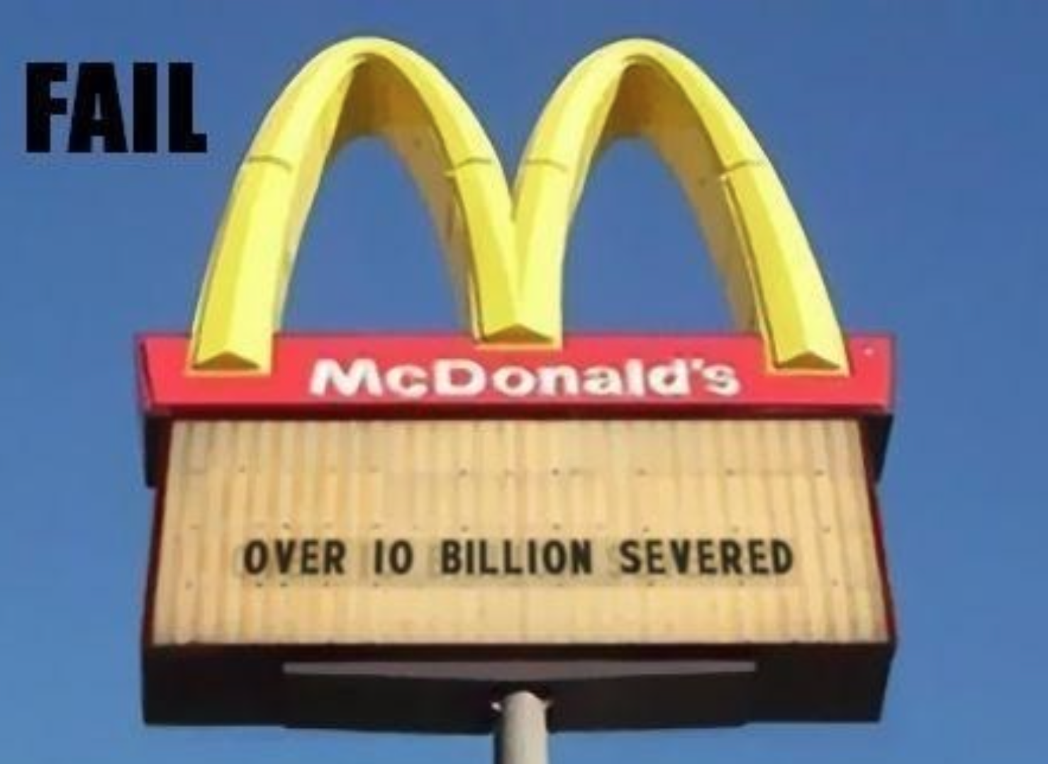
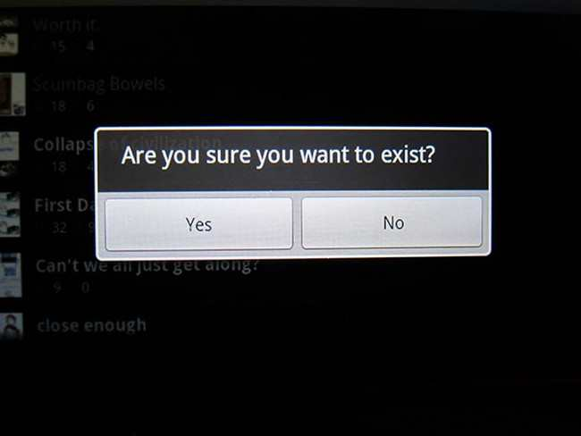
Finally, spell check and read over all work – at best out loud and more than once

Slide 17
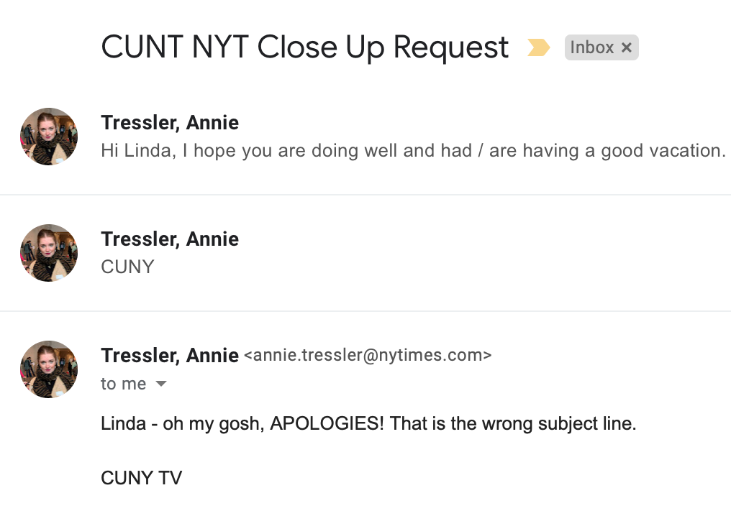
My personal fav…

