Slide 1
The Feature Story

Slide 2
The difference between a news story and a feature story

Slide 3

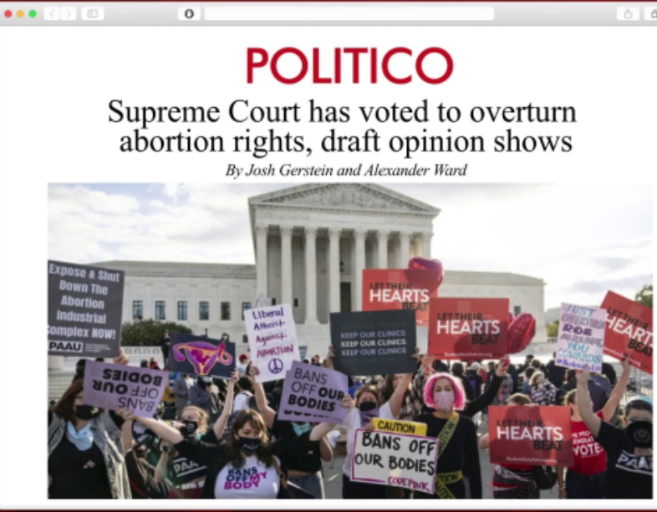
news story May 3, 2022
Feature story May 23, 2022

Slide 4
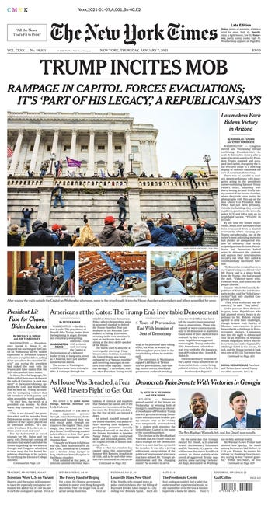
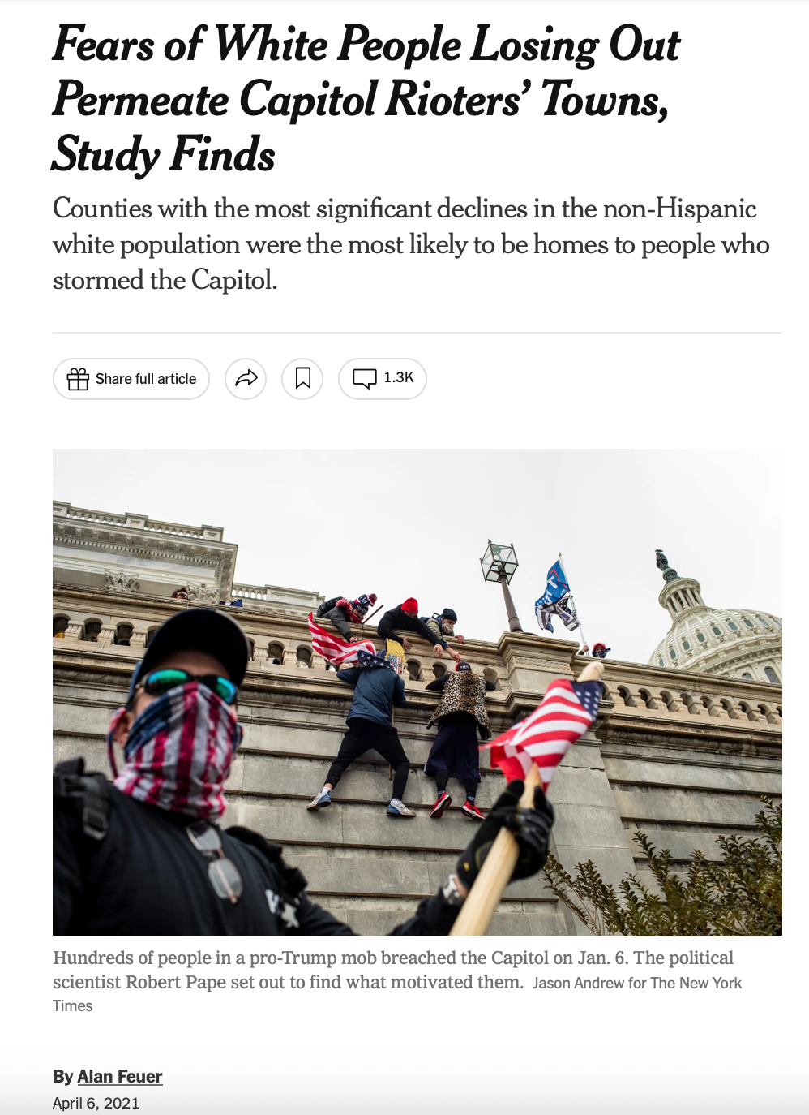
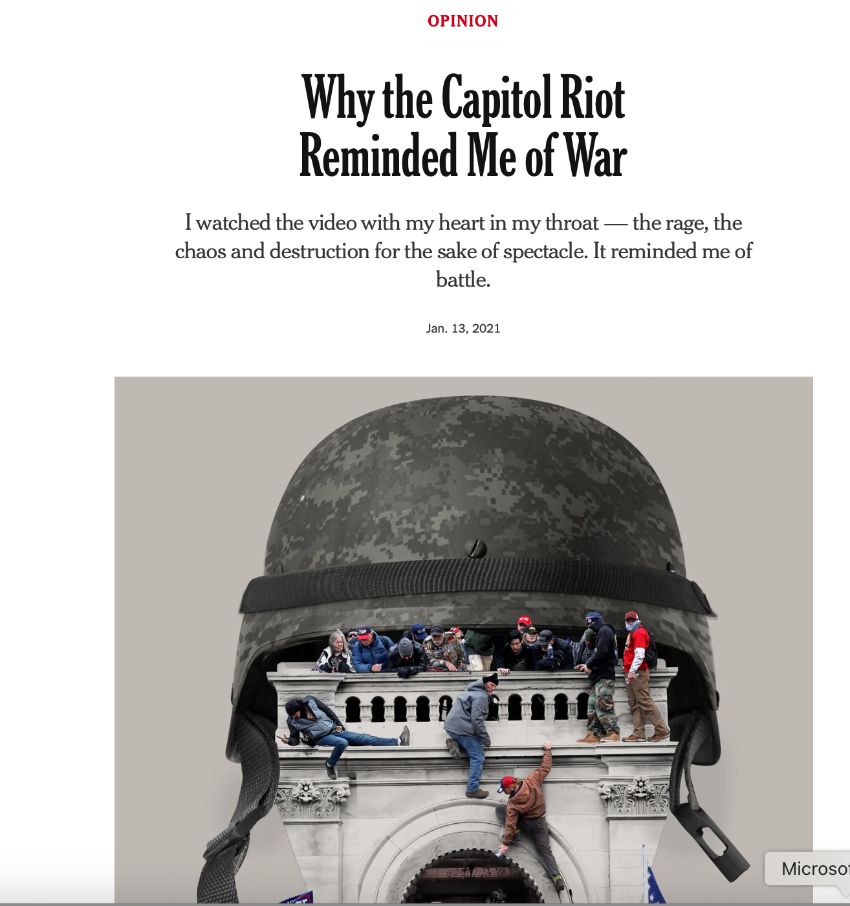

Slide 5
Newsy Feature Stories
A story that follows a news story.
Doesn’t have to be exactly the next day – could be a few days later, weeks, months, years.
Often look at the “why”
It can be a profile, news feature, trend article, op-ed, graphic, etc.

Slide 6
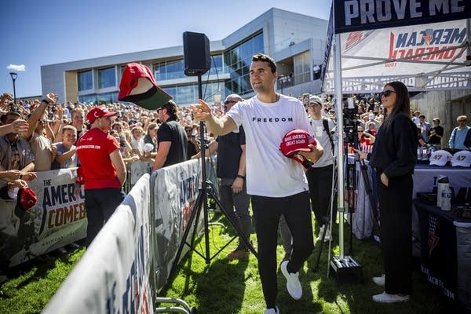
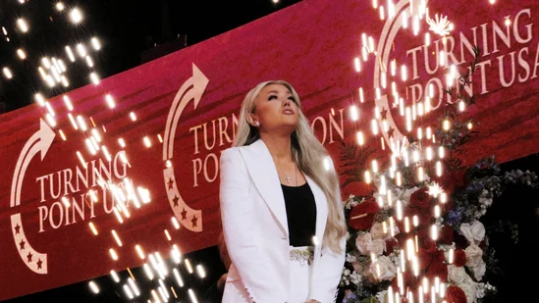
(news) Conservative “activist” Charlie Kirk killed during event in Orem, Utah on September 10, 2025
(feature) The future of Turning Point USA

Slide 7
News vs feature
Though it must have news value, a feature is not rigidly tied to the news.
Takes longer to report and write
Usually touches on a bigger issue than just the obvious.

Slide 8

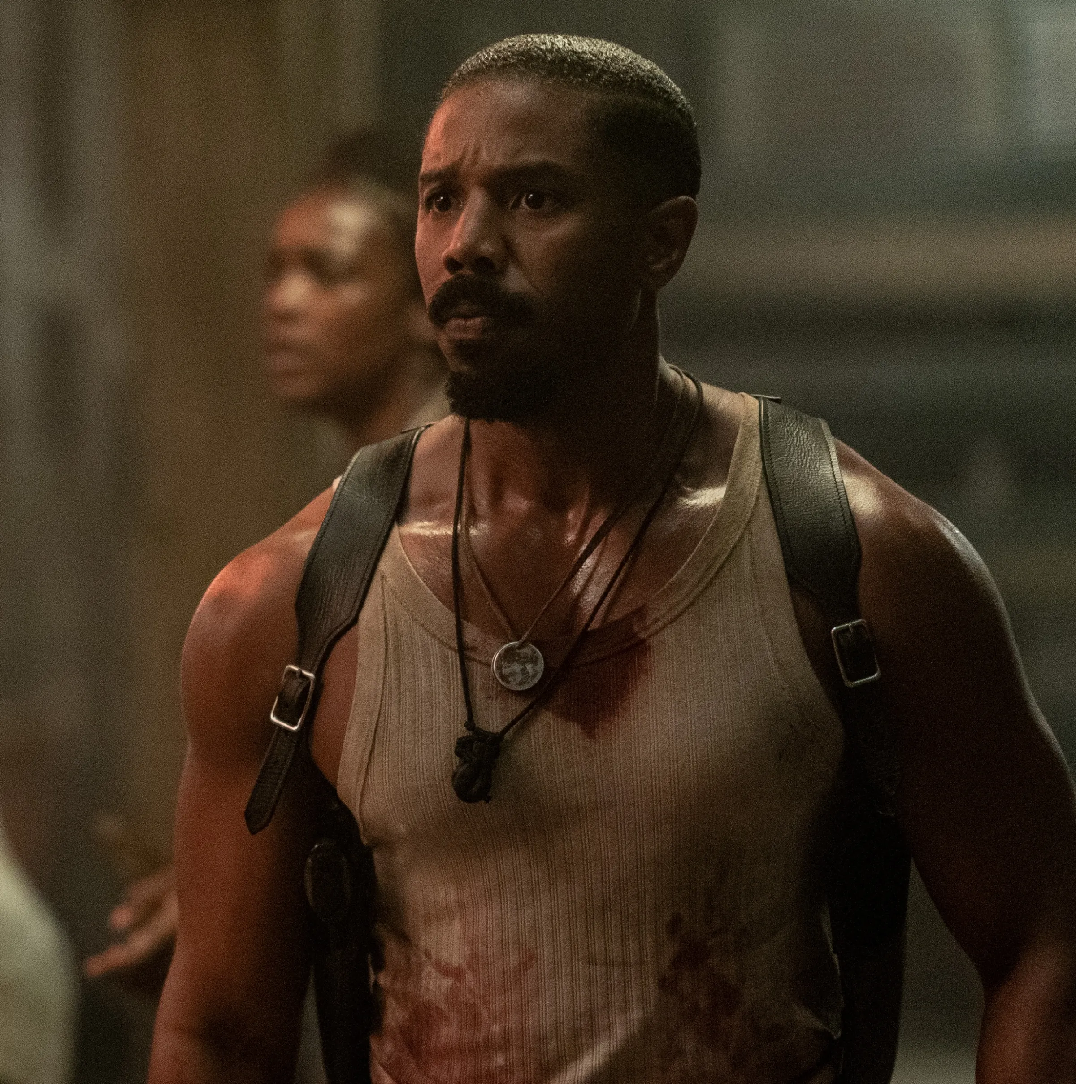
(news) Academy Award Nominations 2026: “Sinners” leads the pack with a record-breaking 16 Oscar nominations, including best picture. “One Battle After Another” received one nomination after another for a total of 13.
(feature)
Why Hollywood fell out of love with “Wicked”

Slide 9
How else is a feature story different from a news story?

Slide 10
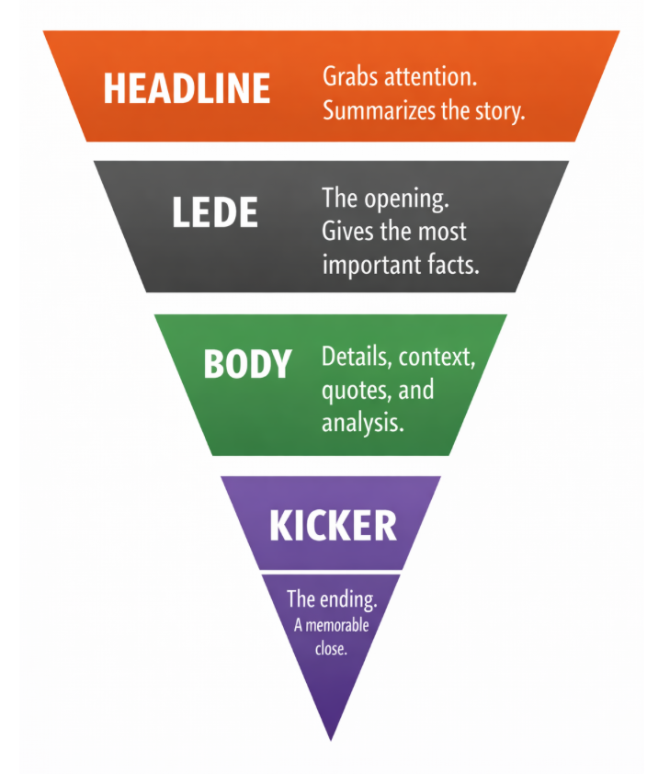
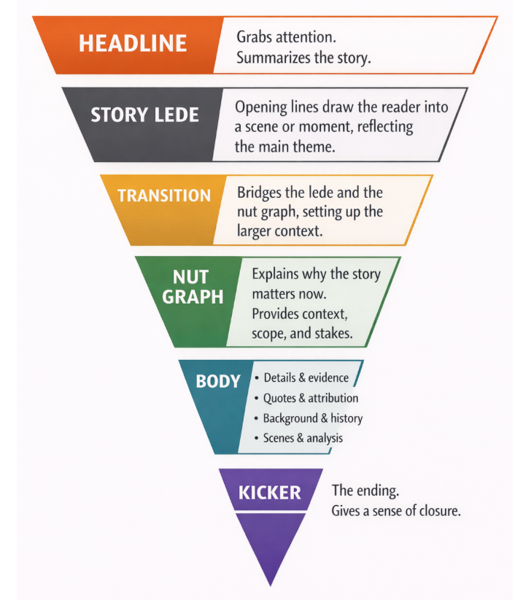
Has a different structure.
The storytelling is generally more creative.
News vs feature story structure

Slide 11
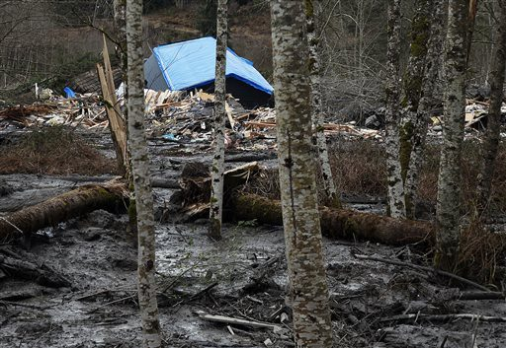
This is the news…
“Huge Washington mudslide kills three and dams river”

Slide 12
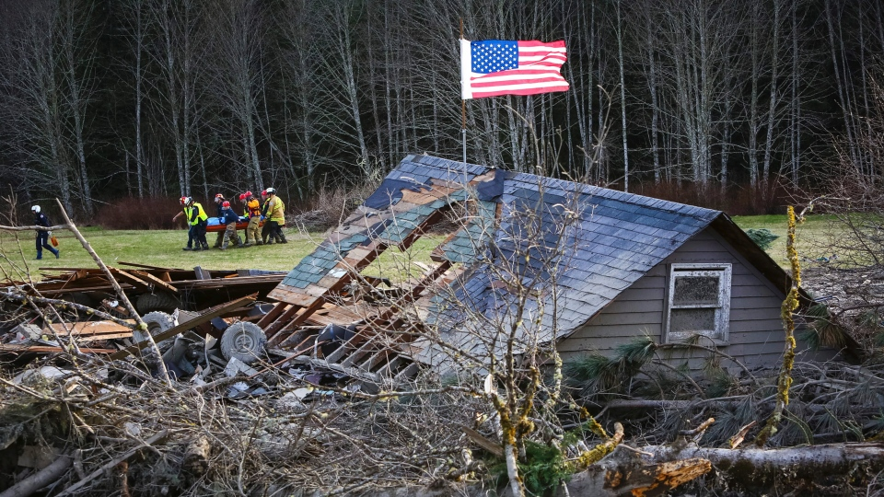
This is a feature…
“In Ocean of Mud, a Plea: Leave Me, Save My Wife”

Slide 13
Feature story ideas: You should have lots of them!

Slide 14
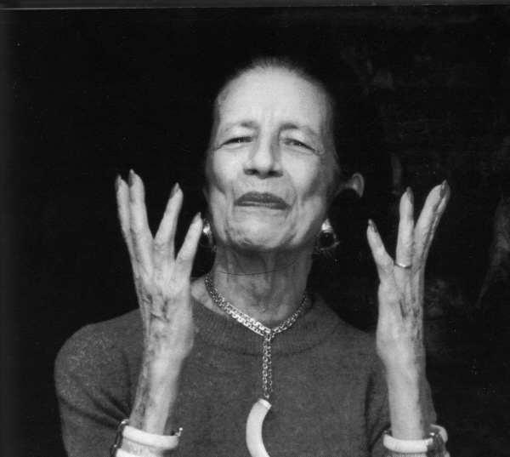
“Give ideas away. Under every idea there's a new idea waiting to be born.” --Diana Vreeland

Slide 15
A good idea:
Must have a news angle/news value.
Must be of interest to your audience

Slide 16
Let’s Keep It Simple...
News
=
What’s New

Slide 17

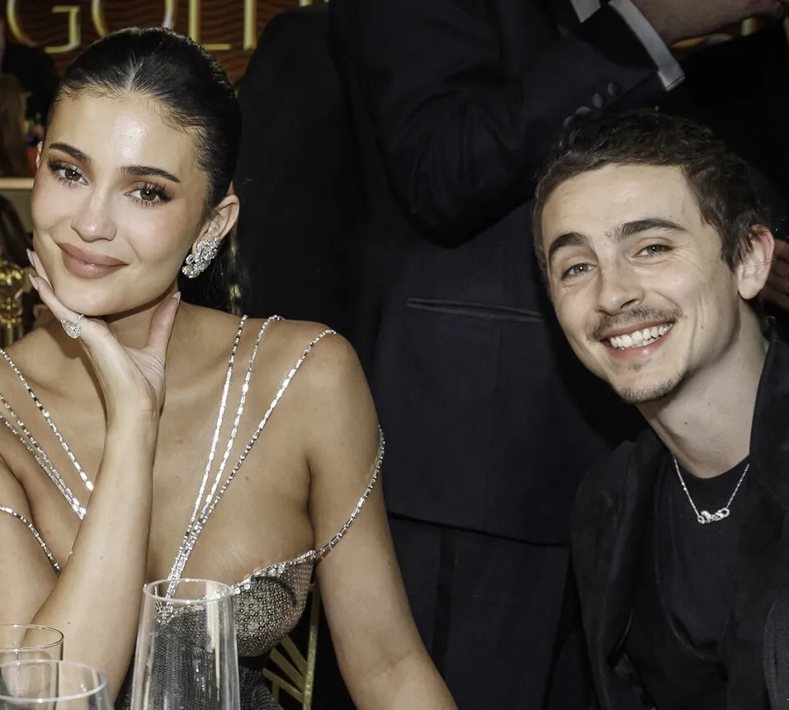
News value the criteria editors, producers and reporters use to decide what news is fit to print or broadcast

Slide 18
For feature story ideas, ask yourself
Why this idea at this time? [AKA: what’s new?]
What does my reader want? Why do my readers/users CARE about this topic? What’s in it for them?

Slide 19
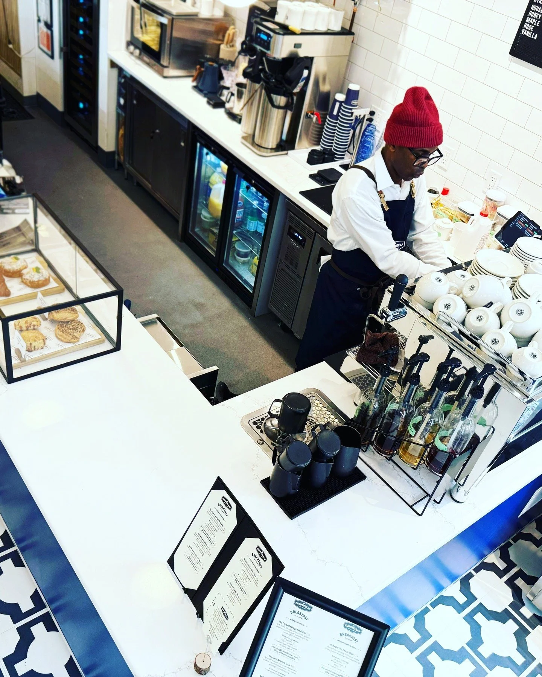
This is news for Harlem, where my mom lives
Copperleaf Bakery opens in Central Harlem
at 2118 Frederick Douglass Blvd between W 114th and W 115th Sts
This stylish new bakery serving breakfast and lunch—there's a spacious seat-yourself area—makes its own croissants and desserts like the ube cheesecake, plus sandwiches, soup and even wine. (thecuriousuptowner.com)

Slide 20
How to add a news angle to your stories. Tie it to:
Something that happened very recently--news
The season
An anniversary
A new study
A trend
An issue students/community residents are buzzing about or that’s really interesting or compelling

Slide 21
How to find ideas:
Read the news—local, national, international. Think of how a current news story might be “spun” for an audience.
Look at newsy websites for news ideas.
Mine your beats – subject or location
Look at community media – tweak or update or offer an original spin.
Keep your ear to the ground. Listen to what other students, family, professors, friends, neighbors are talking about.
Think about how something’s changed.
Consider what’s important to your audience RIGHT NOW.

Slide 22
Academy Award Nominations 2026: “Sinners” leads the pack with a record-breaking 16 Oscar nominations, including best picture. “One Battle After Another” received one nomination after another for a total of 13.

Slide 23
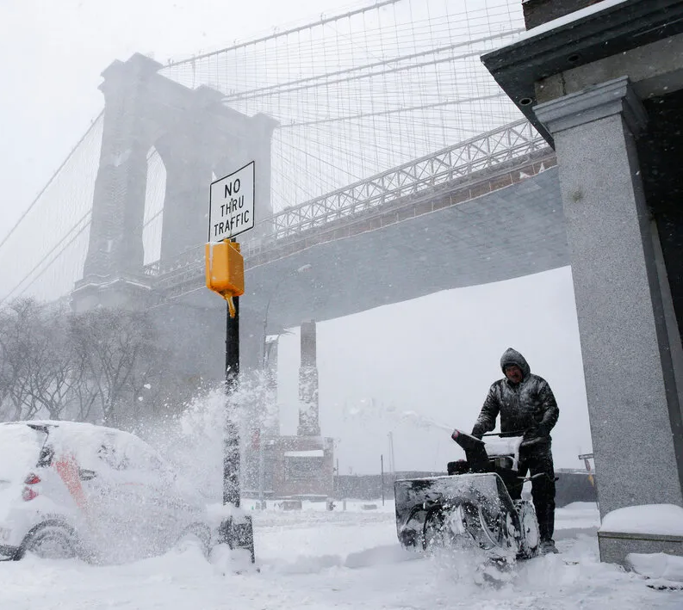
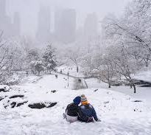
Winter snowstorm slams NYC

Slide 24
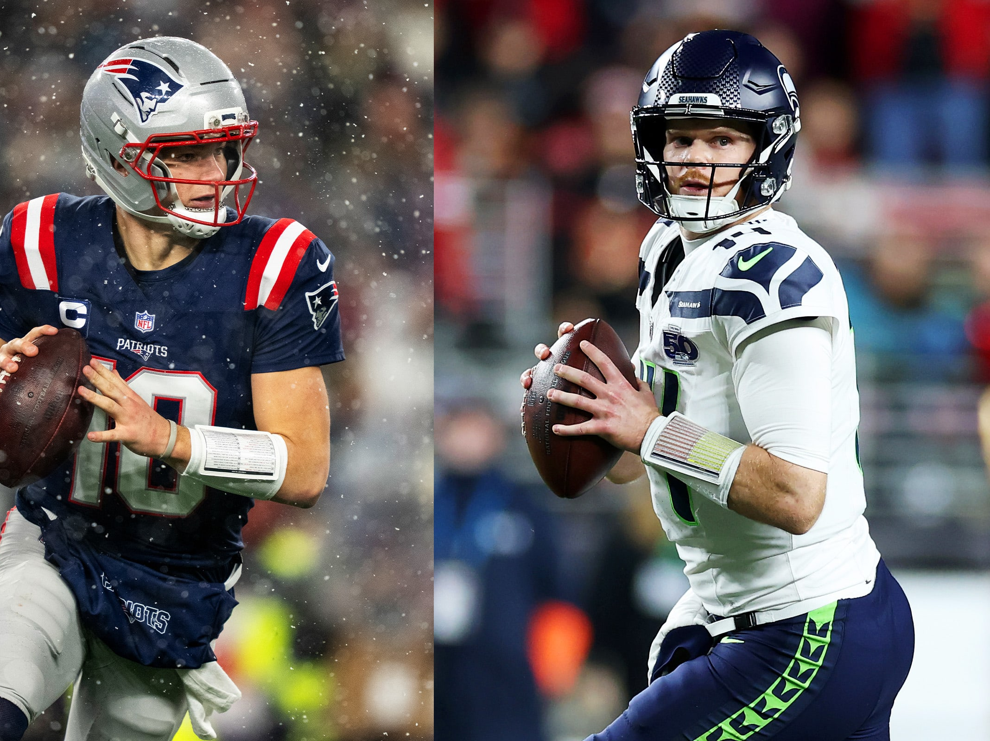
Seahawks and Patriots advance to the Super Bowl

Slide 25
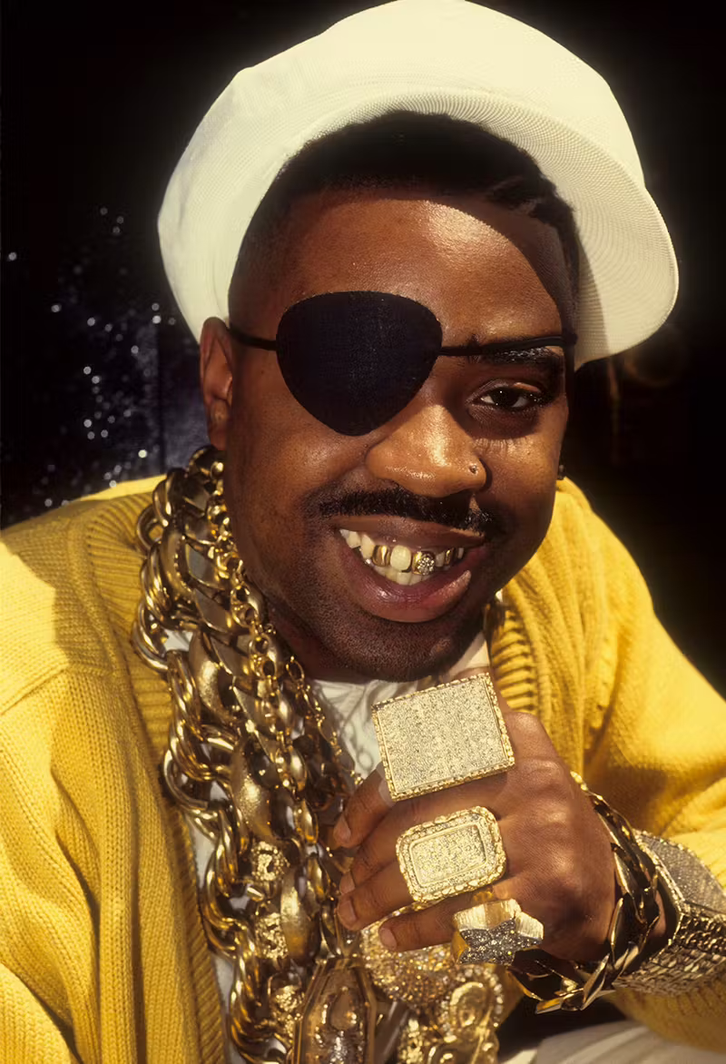
Gold soars to $5K an ounce as global tensions grow

Slide 26

New research points to increased health risks of nano- and microplastics in bottled water

Slide 27

New survey of 800 U.S. managers, directors and executives involved in hiring found Gen Z candidates failing at interviews – unprepared, lack of eye contact, inappropriate attire, asking for unrealistic salaries among the reasons.

Slide 28
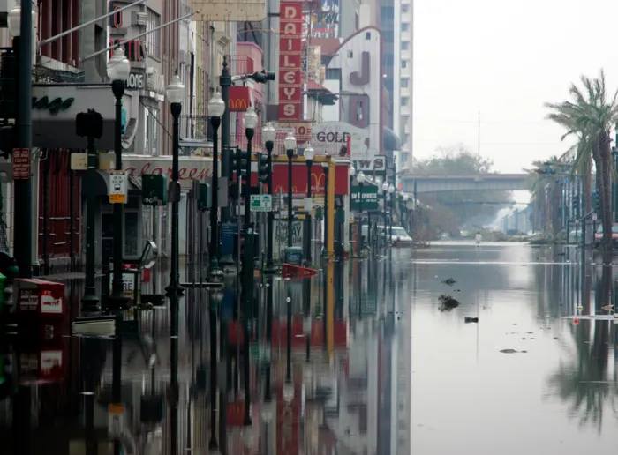
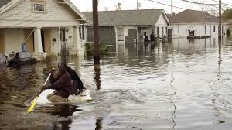
Anniversary Katrina, 2005 – 20 years later

Slide 29
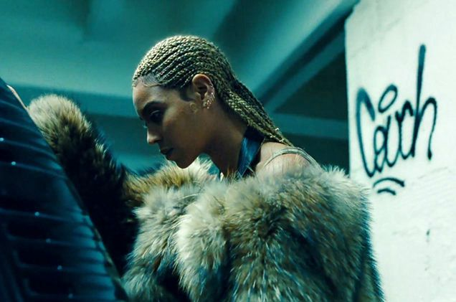
10th anniversary of Lemonade

Slide 30

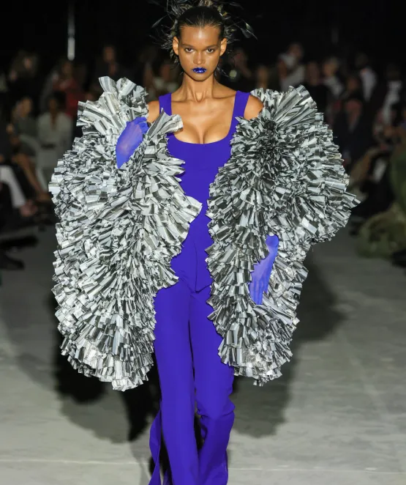
Seasonal

Slide 31

Find a new angle on an ongoing or evergreen story

