Slide 1
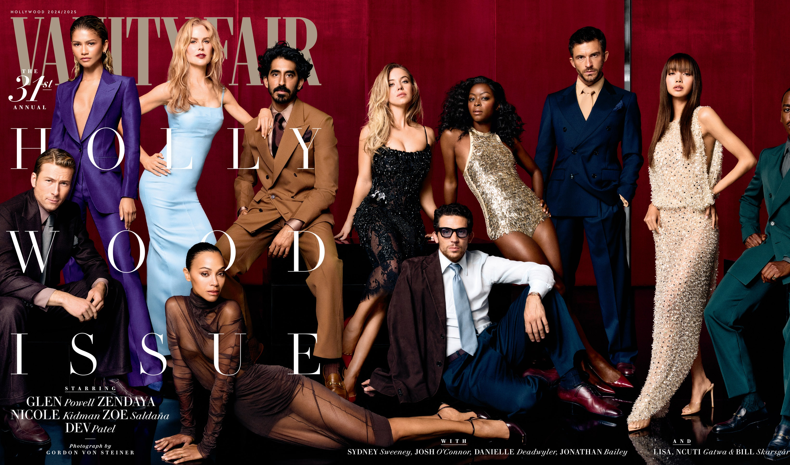
Writing about people

Slide 2
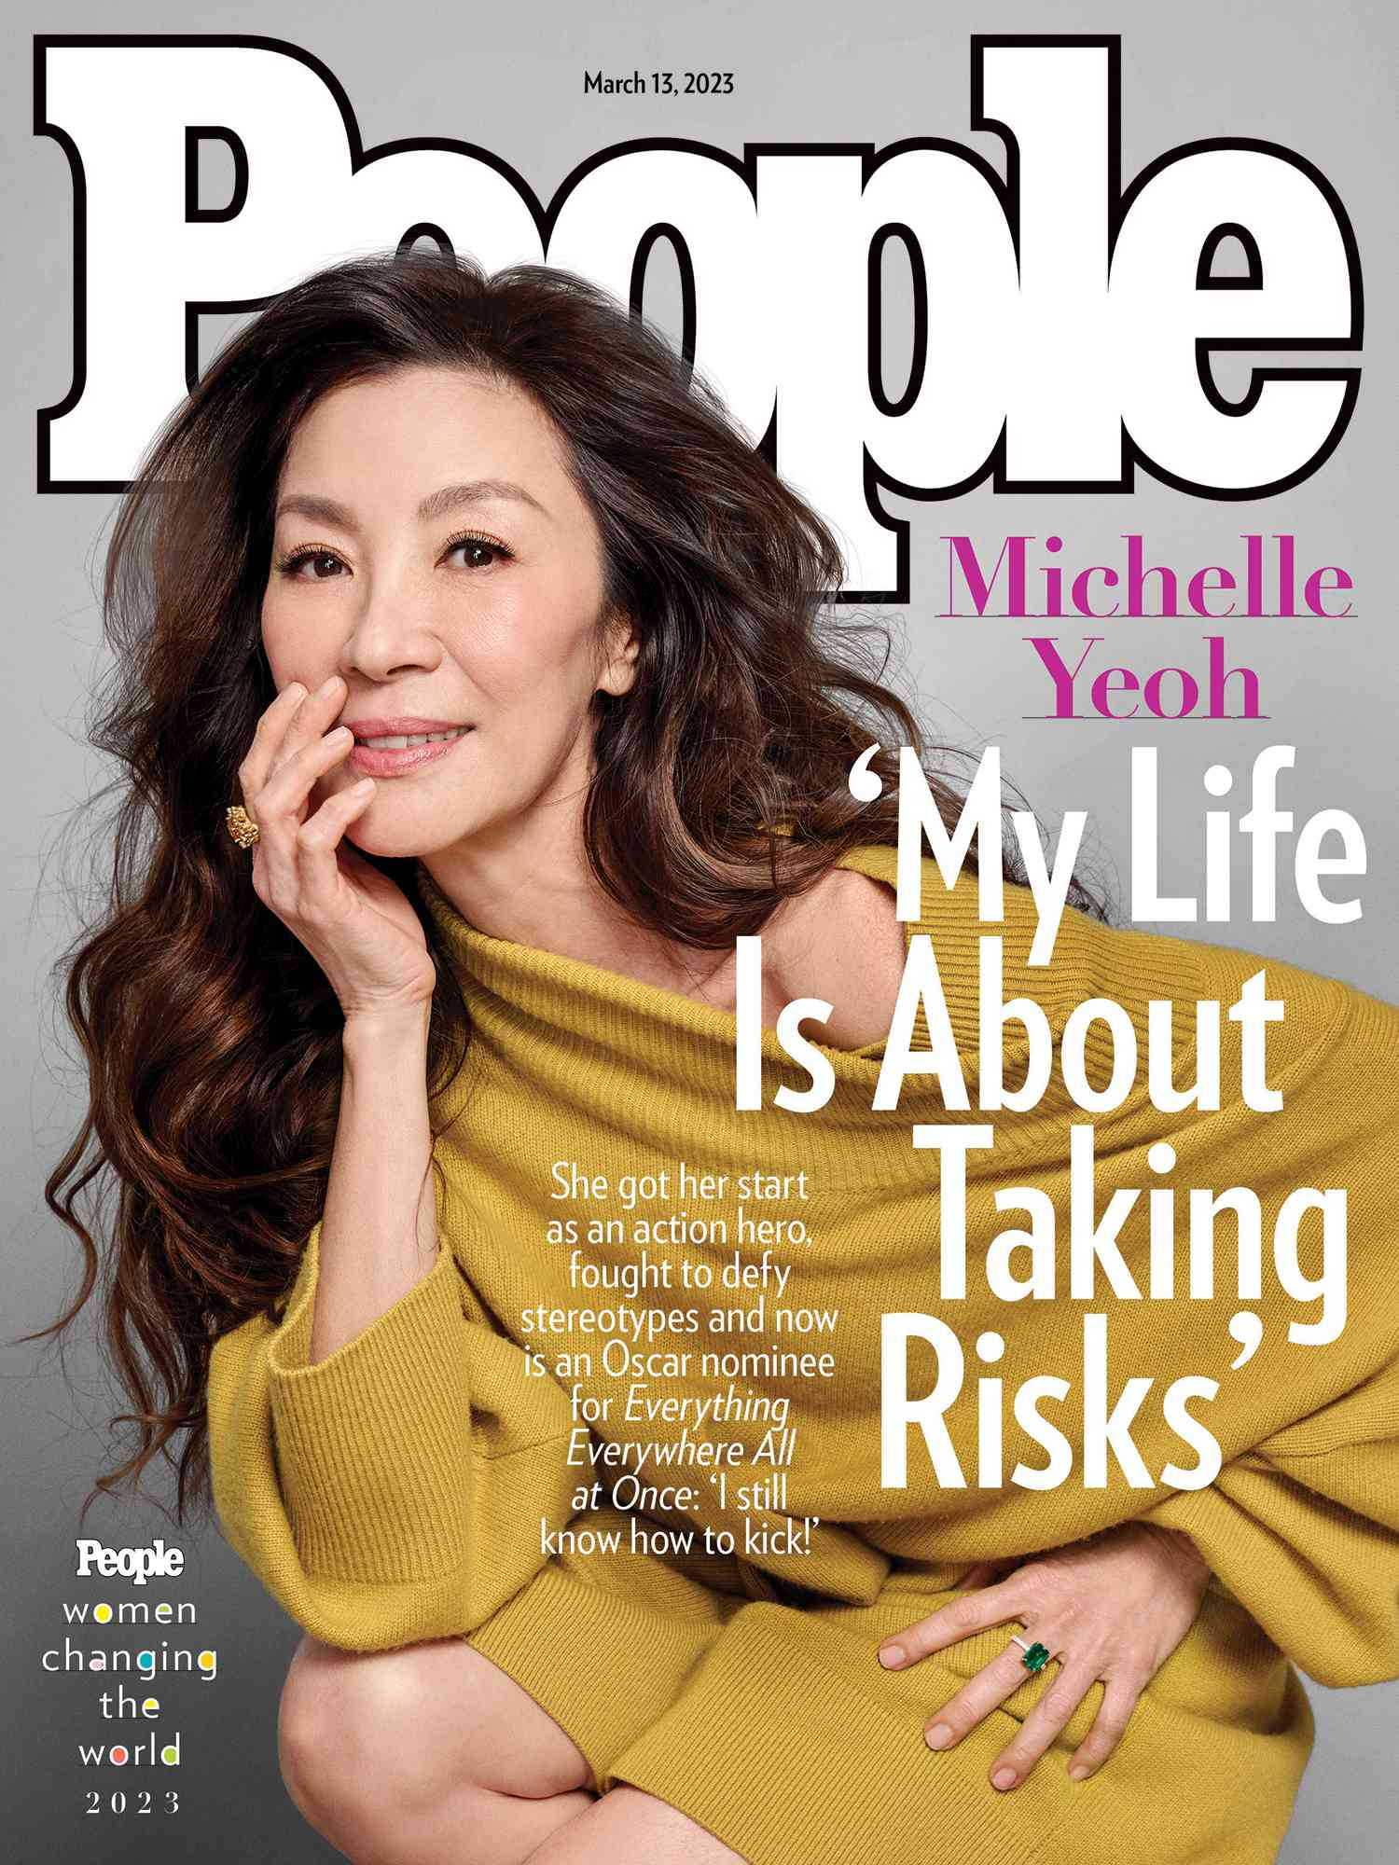
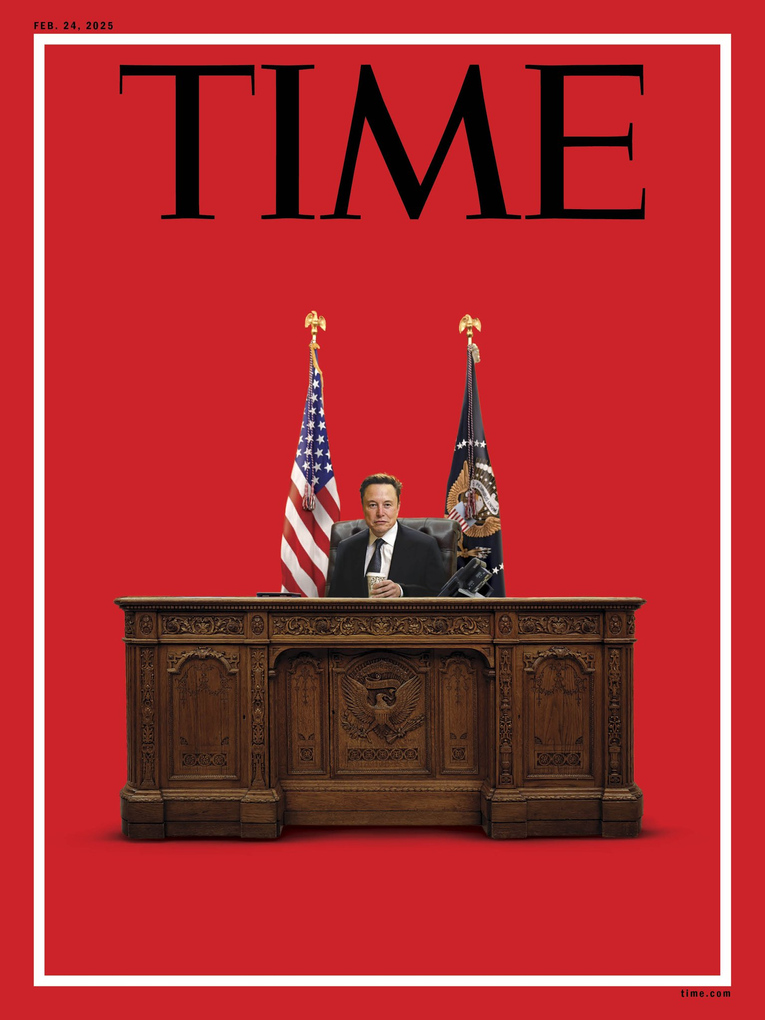
A profile is: a feature story about a person
1,500 × 2,000

Slide 3
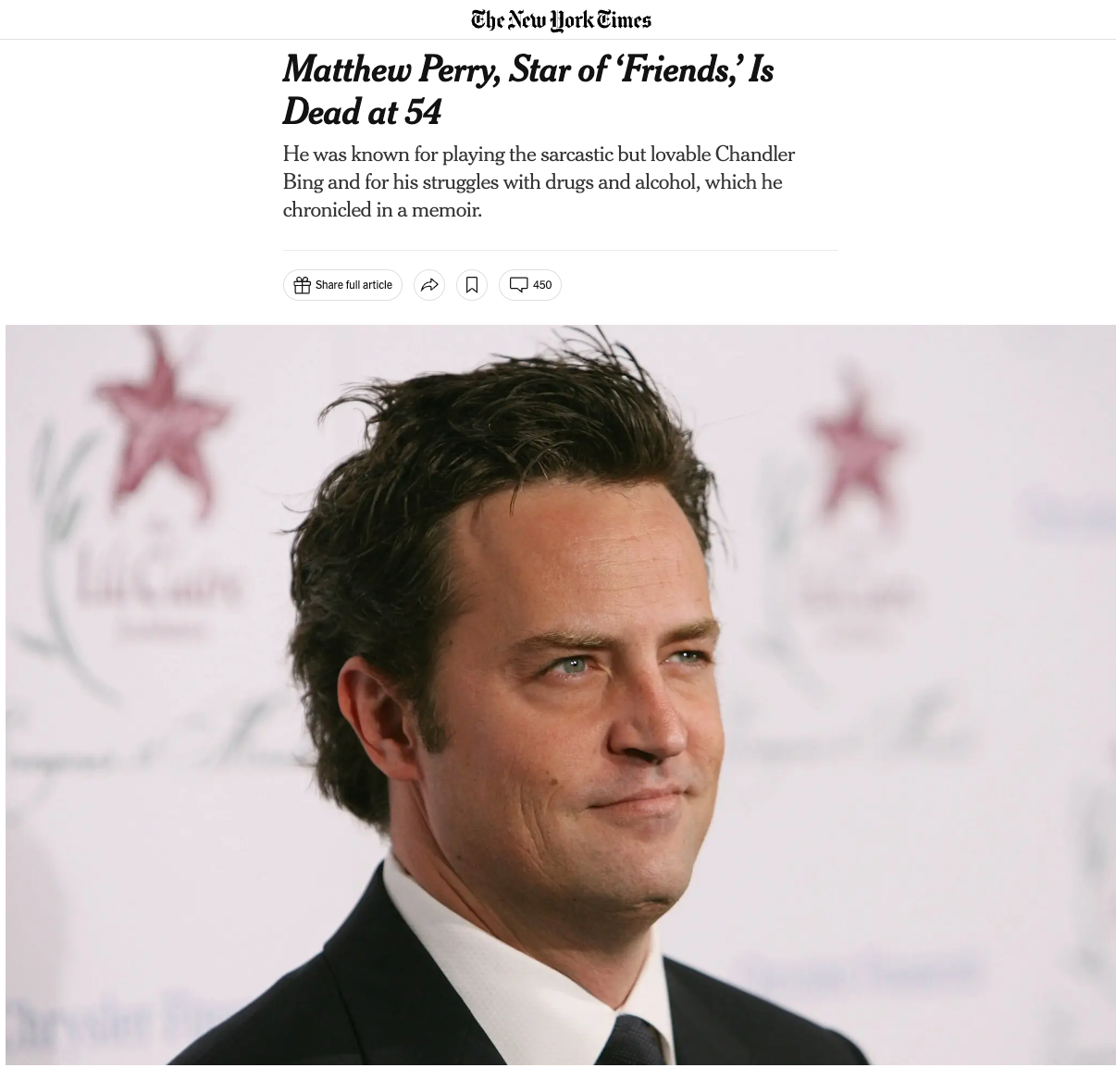

Slide 4
The best profiles….
Have a news or newsy angle
Have nut graphs…though you might not notice them.
Are about something. Don’t write someone’s biography.
And…by the end, the reader should feel like we know the person better.

Slide 5

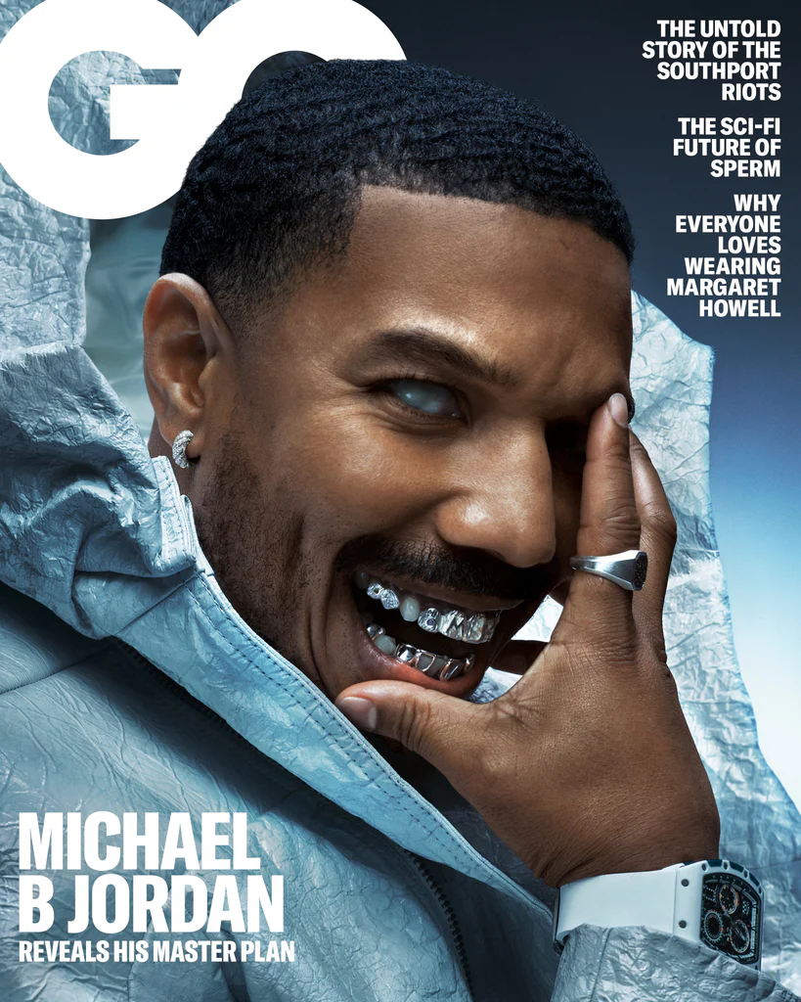
Journalistic profiles always have some kind of news angle – something new

Slide 6
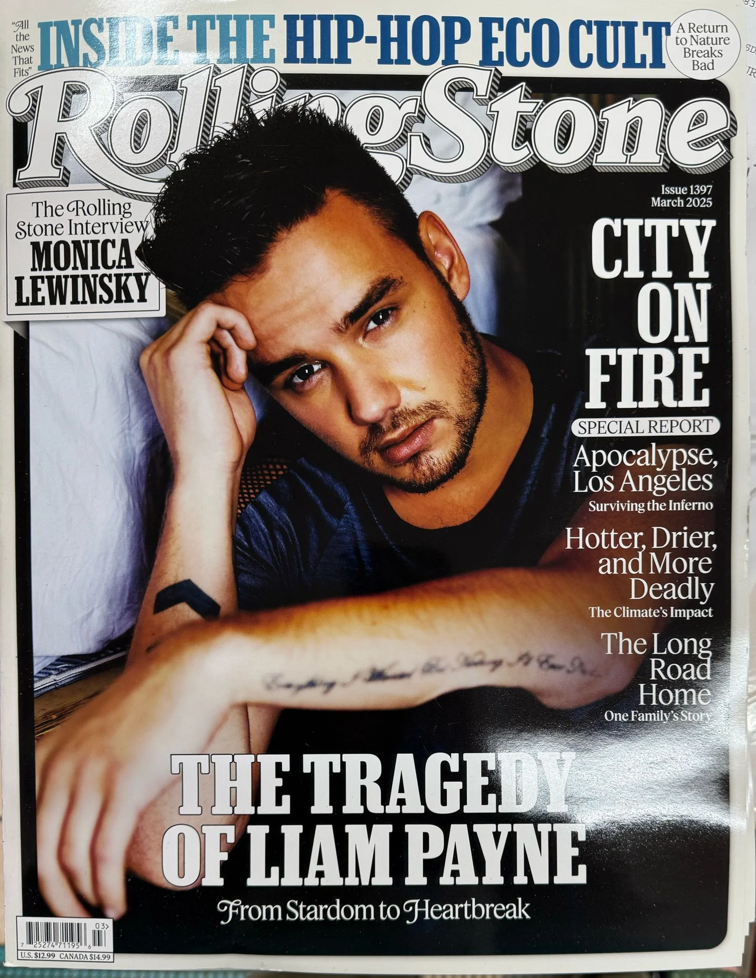
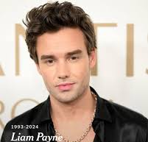


Slide 7
Best profiles have a spin

Slide 8
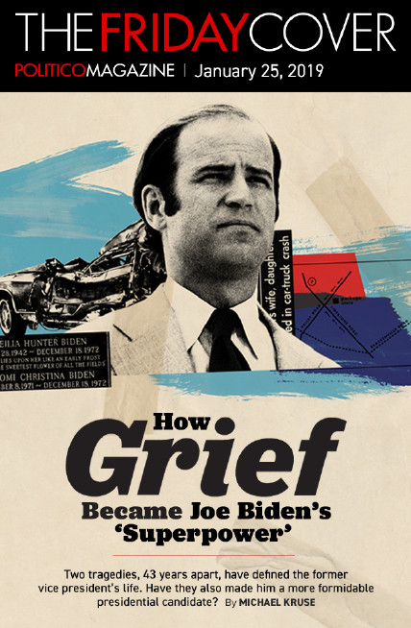
Profiles are about someone and about something

Slide 9
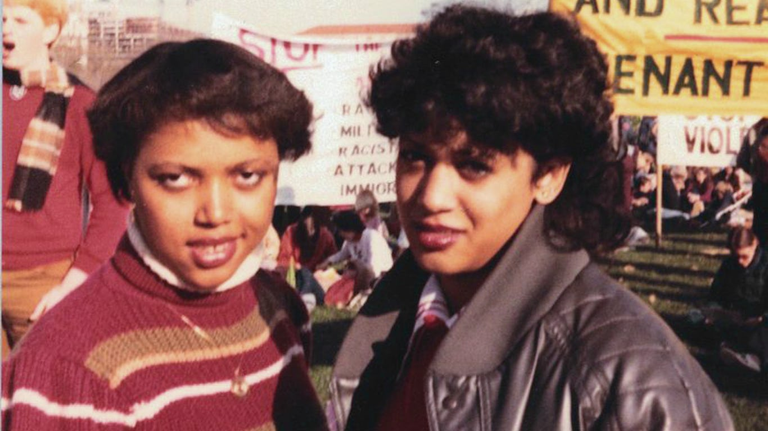
Is Kamala Harris Black Enough?
By Robin Givhan, Washington Post SEPTEMBER 16, 2019

Slide 10
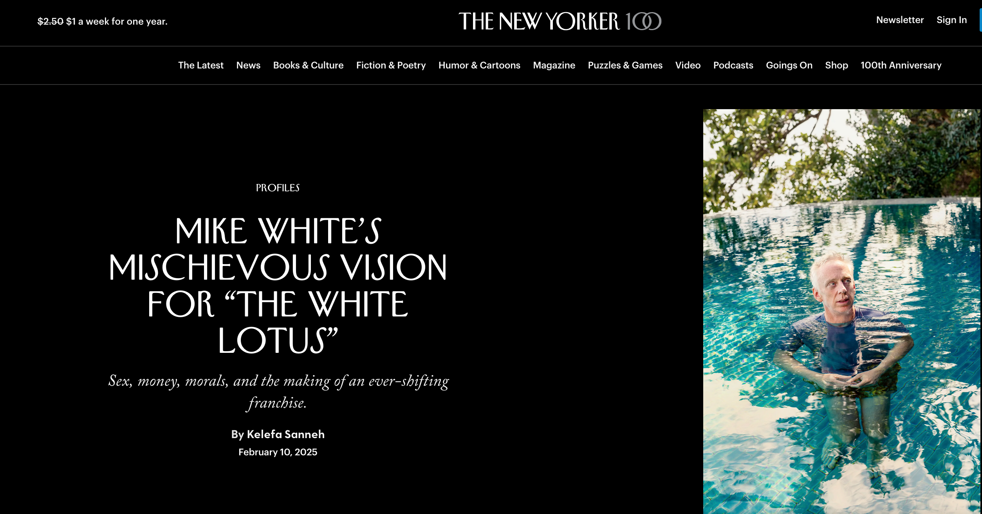
When considering who to profile think:
Why this person at this time? What’s the news angle?
Why this person for this publication?

Slide 11
Each of these people is on the cover for a reason

Slide 12
Profile Writing Guidelines
Your story must be about someone and also about something.
Make the reader understand why we should care about the person, why he/she/they are interesting.
Allow your subject to speak for him/herself/themselves by using direct quotes

Slide 13
Interview a person in person, take a photo, write a profile
Headline: Who is the person and why are they interesting
Story lede: Write an anecdotal or narrative lede for this kind of piece.
Nut graph: what the story is about. In other words, why is this person significant? Why should we care about him/her/them? What’s interesting? What’s new?
Body: Discuss the person, use direct quotes from them – include one quote from someone else about the person
Don’t write in first person – you can edit the quotes down Ending/kicker: Finish big w/ a great quote or nice wrap-up.

