Slide 1
The Feature Story Deconstructed

Slide 2
How else is a feature story different from a news story?
Though newsy, not rigidly tied to the news.
It usually touches on a bigger issue than just the obvious.
It has a different structure.
The storytelling is generally more creative.

Slide 3
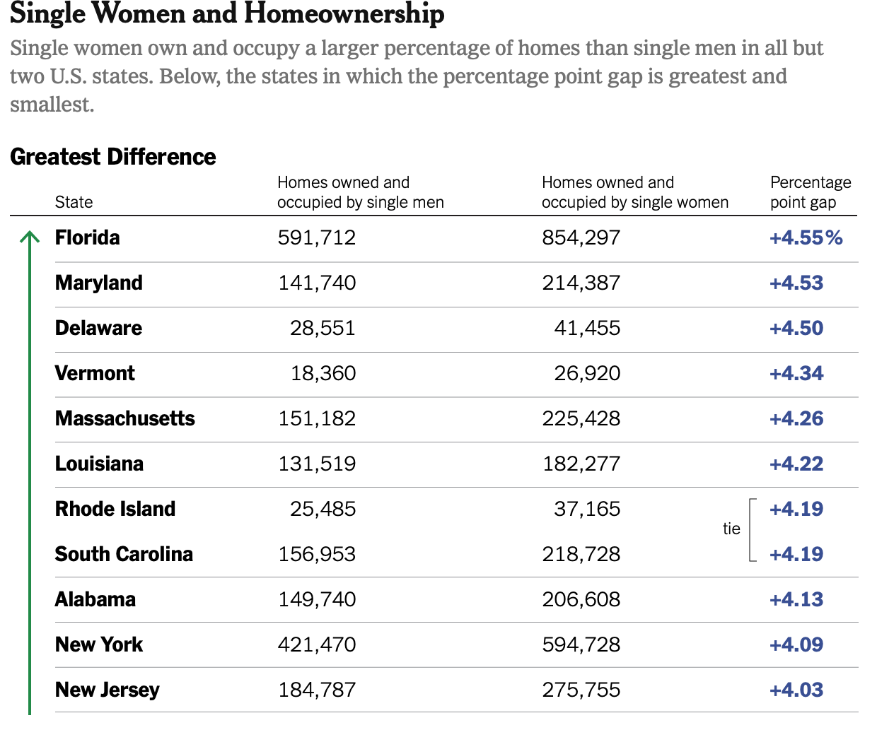
This is the news…
Single Women Own More Homes Than Single Men

Slide 4

This is the news…
Half of black gay men and a quarter of Latino gay men projected to be diagnosed within their lifetime
If current HIV diagnoses rates persist, about 1 in 2 black men who have sex with men (MSM) and 1 in 4 Latino MSM in the United States will be diagnosed with HIV during their lifetime, according to a new analysis by researchers at the Centers for Disease Control and Prevention (CDC). The study, presented today at the Conference on Retroviruses and Opportunistic Infections in Boston, provides the first-ever comprehensive national estimates of the lifetime risk of an HIV diagnosis for several key populations at risk and in every state.

Slide 5

This is the feature…

Slide 6
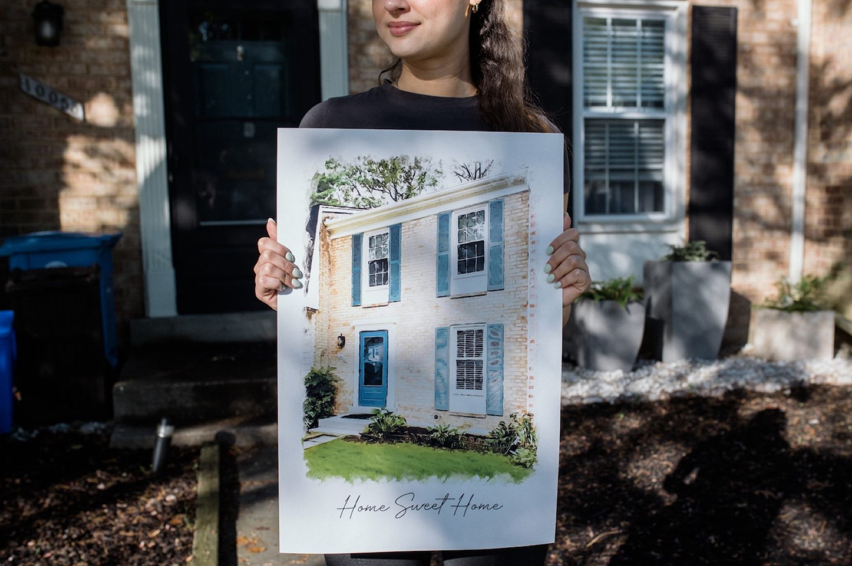
This is a feature…
More single women than men buy homes. That doesn’t mean it’s easy.
From competing against couples to dealing with biased real estate agents and contractors, these are the tales of navigating the housing market alone

Slide 7


Slide 8
Parts of a news story
Headline
Lede
Body, which includes elaboration, reaction quotes that support the sides of the story--if there are sides.
Ending, kicker

Slide 9
The parts of a feature story
Headline
Lede
Nut graph
Body, which includes elaboration, reaction quotes that support the sides of the story--if there are sides.
Ending, conclusion, kicker

Slide 10
Story lede
Story ledes can be one paragraph or a few
Unlike the “just the facts” news lede, the soft lede is generally descriptive and teases the reader
Doesn’t have the “ws”
Often focuses on a person who offers an example of the larger point of the story
Most magazine articles use story ledes

Slide 11
Nut graph, sometimes called billboard
Nut graph is a paragraph (or two) that explains what the story is about.
It contains the facts
Most of the rest of the story supports and amplifies what you’ve written in the nut graph
If you write a strong, clear nut graph, your story will be easier to organize.

Slide 12
Rick Alexander, a master carpenter in Tampa, Florida, has given up searching for a job after months of effort. The disappointment, he believes, has become unbearable.
“When you were in high school and kept asking the head cheerleader out for a date and she kept saying ‘no,’ at some point you stopped asking her,” says Alexander, 41. “It becomes a ‘why bother’ scenario.”
Story lede

Slide 13
Story lede: Rick Alexander, a master carpenter in Tampa, Florida, has given up searching for a job after months of effort. The disappointment, he believes, has become unbearable.
“When you were in high school and kept asking the head cheerleader out for a date and she kept saying ‘no,’ at some point you stopped asking her,” says Alexander, 41. “It becomes a ‘why bother’ scenario.”
Transition: Alexander represents one of a growing number of hidden casualties of the U.S. economy.
Nut graph: Every month millions of Americans are left out of the unemployment rate. The Bureau of Labor Statistics last week reported the official jobless rate as 4 percent for the month of January. But to be included in that measure, a worker must have actively looked for a job at some point in the preceding four weeks.
For an increasing number of people in this country who would prefer to be working, that is not the case.
Headline: Out of Work, Too Down to Search
Subhed: Why Millions of Americans Have Been Left Off Jobless Rolls

Slide 14
Reminder: parts of a feature story
Headline
Lede
Nut graph
Body, which includes elaboration, reaction quotes that support the sides of the story--if there are sides.
Ending, conclusion, kicker

Slide 15

How can you improve as a journalist?
Read lots of good feature stories.
Pay attention to the format, particularly the story ledes & nut graph/s.
Write, write, write.

Slide 16
This is your headline and nut graph; write a story lede
New Legislation Helps Airbnb Make a Comeback in the City
The New York City Council is considering a new measure to allow some landlords to list their properties on Airbnb and other platforms aimed at tourists and temporary visitors. The move comes after a city crackdown eliminated thousands of illegal short-term rentals in 2023.
The bill, introduced late last year by Councilmember Farah Louis of Brooklyn, would permit rentals of less than 30 days at hundreds of thousands of small properties across the city.
The proposal is earning support from homeowners who say the listings allow them to earn extra income without a full-time tenant and to lease their units for parts of the year.
But it’s also reigniting opposition from tenant groups who say those listings take much needed homes off the market and worsen the city’s already-severe housing crisis.

Slide 17
Feature Story Tips
You must write a story lede for the first assignment
Follow feature story format exactly
Understand completely and correctly what the news is
Make sure the “news” or trend is included in your nut graph
Quote at least three people who care about the issue – a mix of experts and affected people.

