Slide 1
The Feature Ideas

Slide 2
What’s the difference between a news story and a feature story?

Slide 3

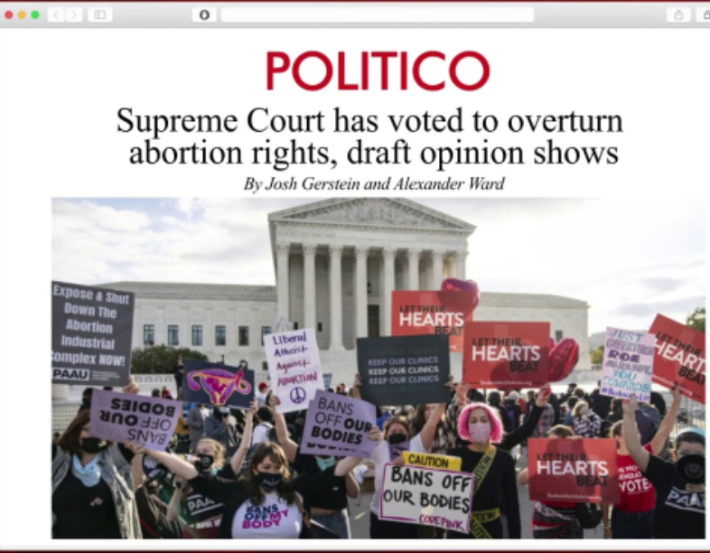
news story May 3, 2022
Feature story May 23, 2022

Slide 4
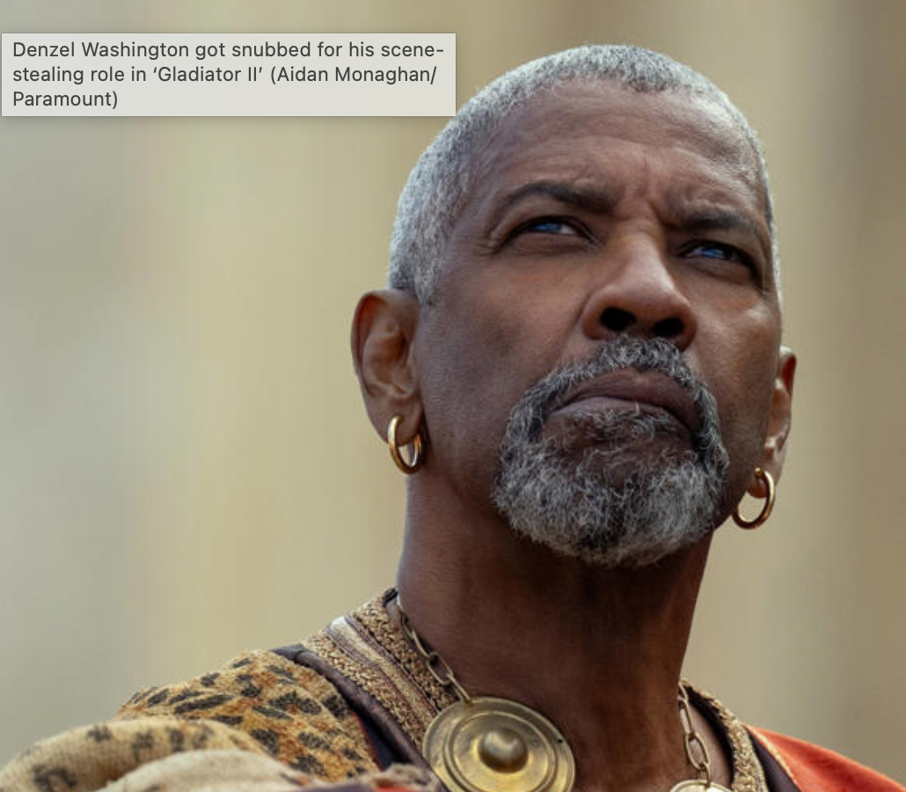
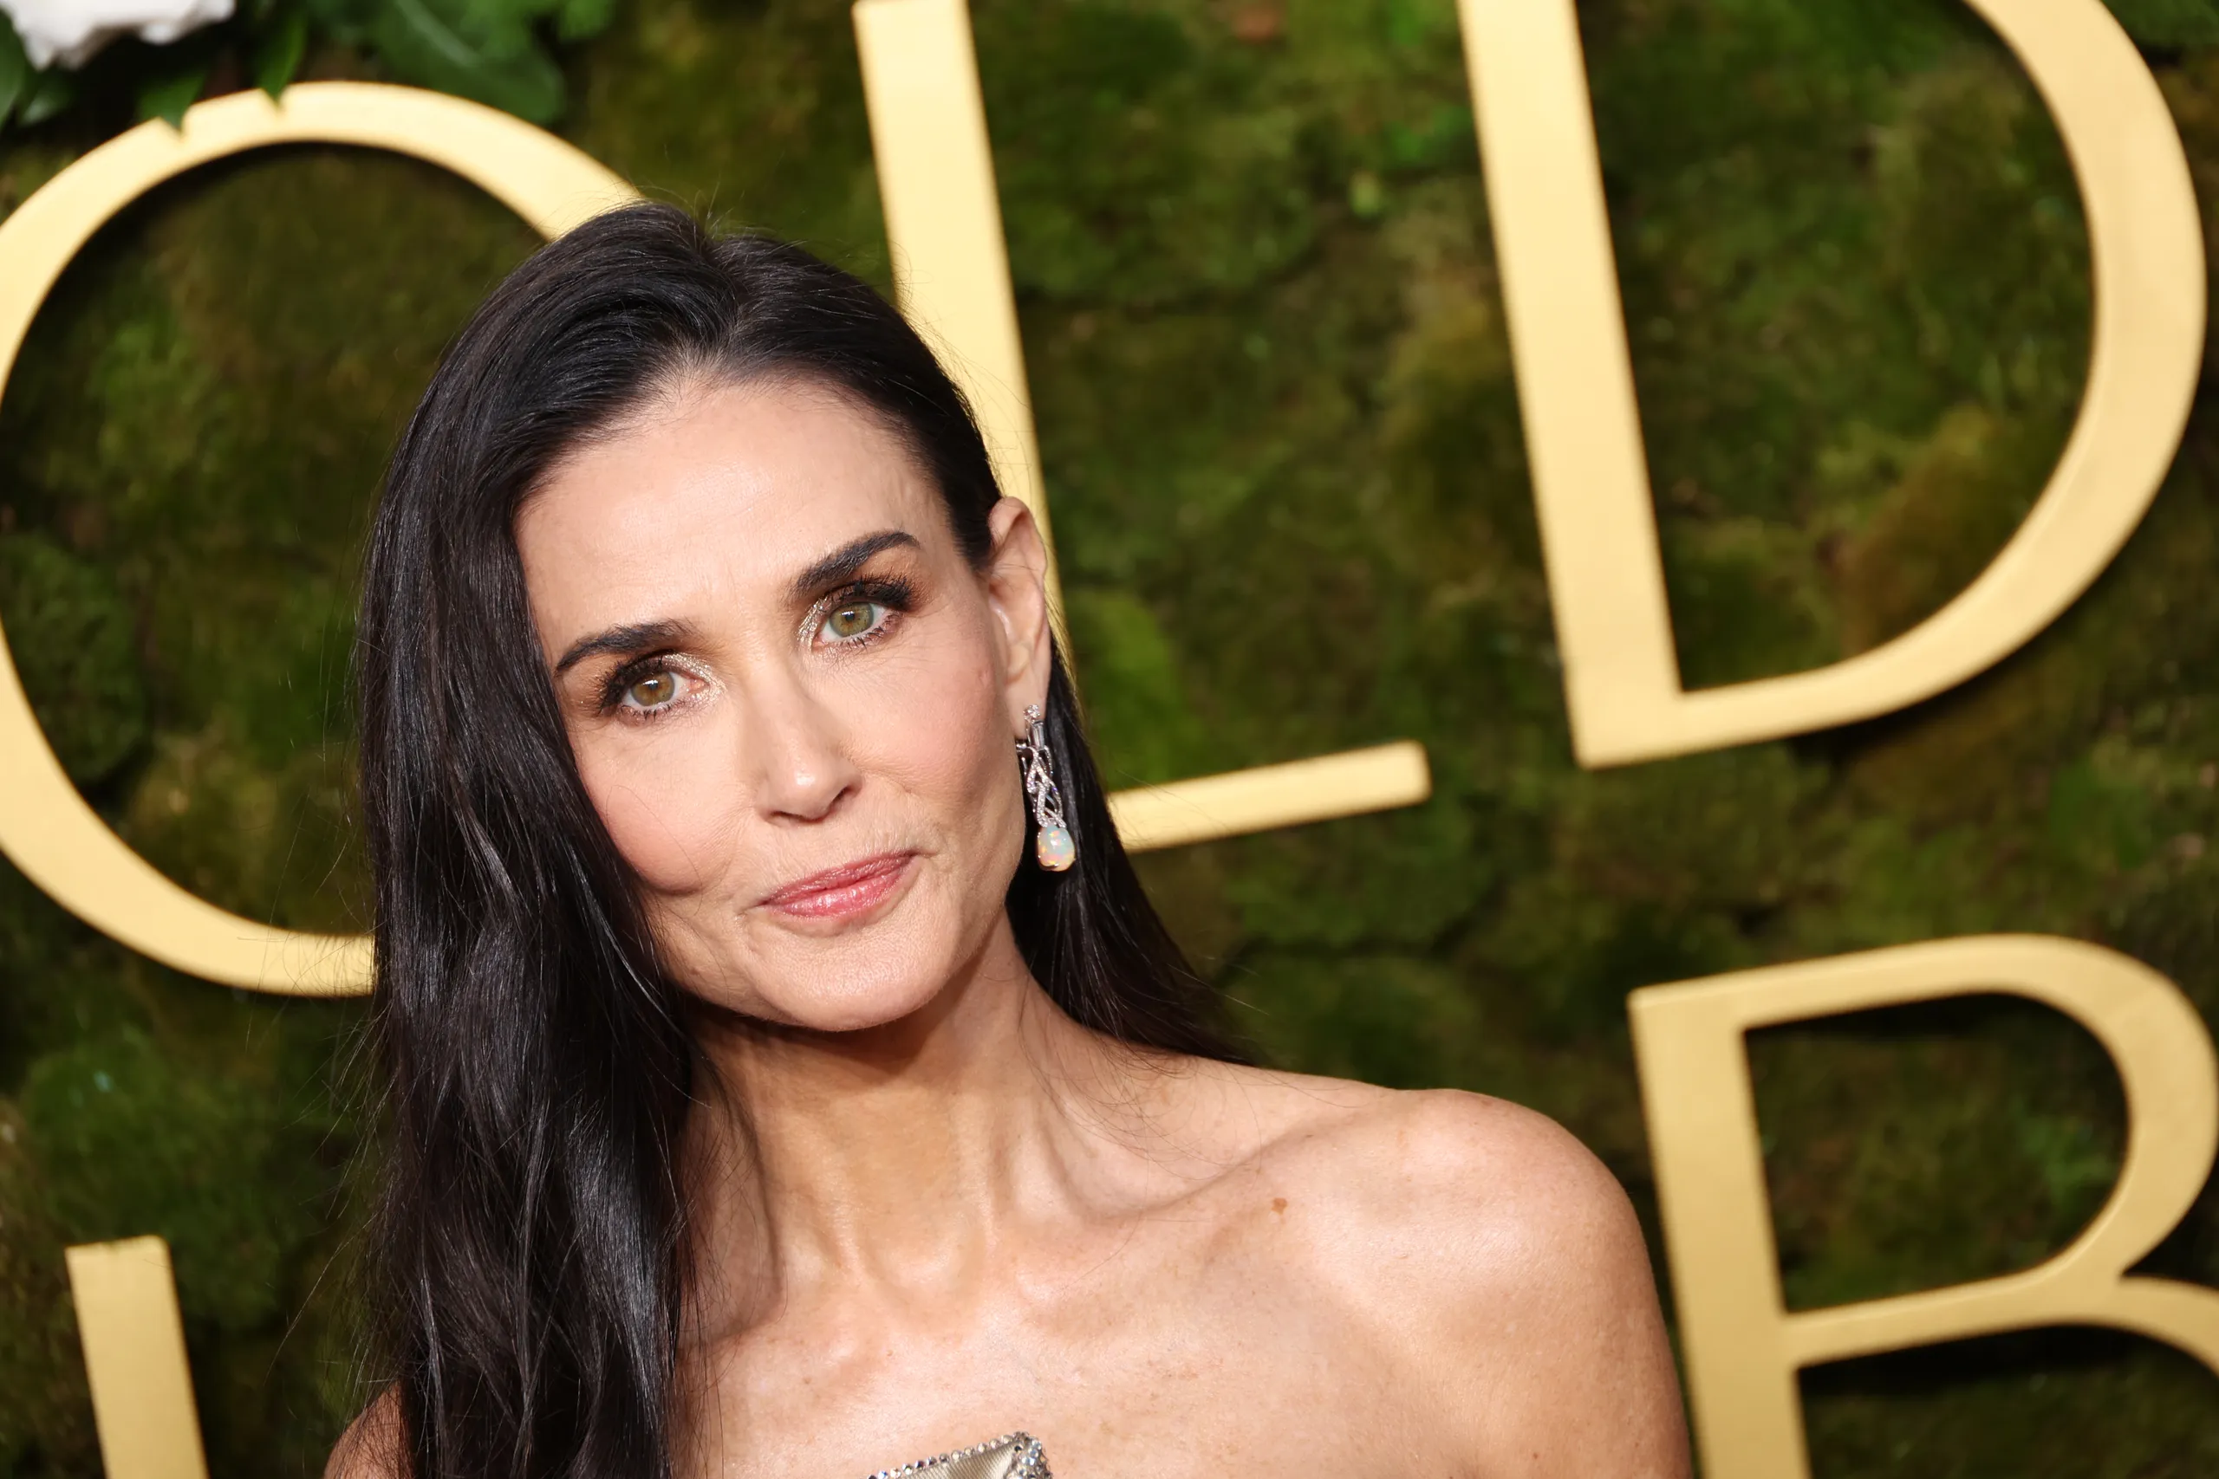
Academy Award Nominations 2025: ‘Emilia Pérez’ Leads With 13 Nods, ‘Wicked’ and ‘The Brutalist’ Follow With 10, Jan. 23, 2025
The 7 Biggest 2025 Oscar Snubs
Demi Moore’s career comeback

Slide 5
Newsy Feature Stories
A story that follows a news story.
Doesn’t have to be exactly the next day – could be a few days later, weeks, months, years.
Often look at the “why”
It can be a profile, news feature, trend article, op-ed, graphic, etc.

Slide 6
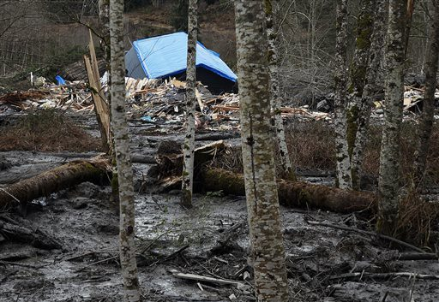
This is the news…
“Huge Washington mudslide kills three and dams river”

Slide 7
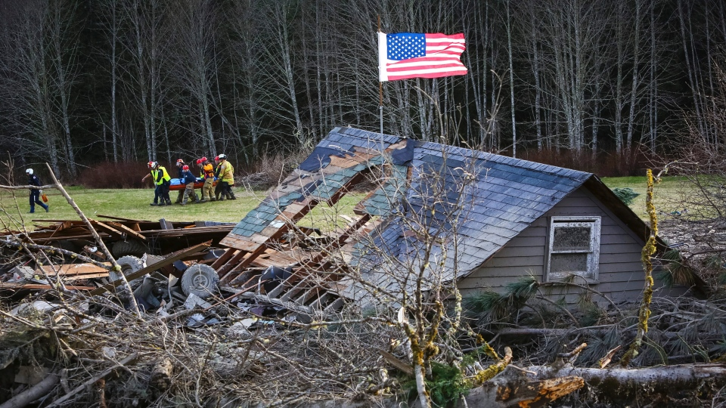
This is a feature…
“In Ocean of Mud, a Plea: Leave Me, Save My Wife”

Slide 8
How else is a feature story different from a news story?

Slide 9
News vs feature
Though newsy, not rigidly tied to the news.
Takes longer to report and write
Usually touches on a bigger issue than just the obvious.
Has a different structure.
The storytelling is generally more creative.

Slide 10
You should have millions of ideas!

Slide 11
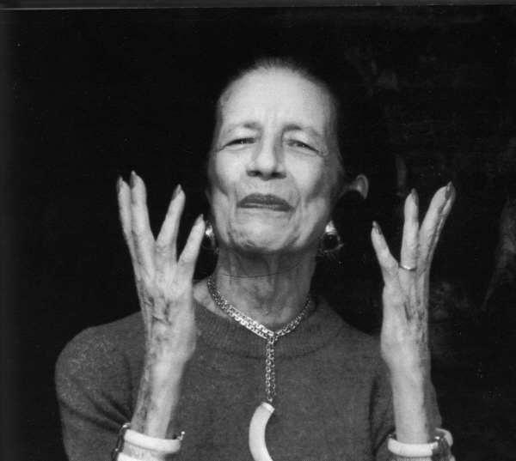
“Give ideas away. Under every idea there's a new idea waiting to be born.” --Diana Vreeland

Slide 12
A good idea:
Must have a news angle.
Targeted to your particular publication. It must be something your reader/user wants.

Slide 13
For feature story ideas, ask yourself
Why this idea at this time? [AKA: what’s new?]
What does my reader want? Why do my readers/users CARE about this topic? What’s in it for them?

Slide 14
How to add a news angle to your stories. Tie it to:
Something that happened very recently--news
The season
An anniversary
A new study
A trend
An issue students/community residents are buzzing about or that’s really interesting or compelling

Slide 15
How to find ideas:
Read the news—local, national, international. Think of how a current news story might be “spun” for an audience.
Look at newsy websites for news ideas.
Mine your beats – subject or location
Look at community media – tweak or update or offer an original spin.
Keep your ear to the ground. Listen to what other students, professors, friends, neighbors are talking about.
Think about how something’s changed.
Consider what’s important to your audience RIGHT NOW.

Slide 16
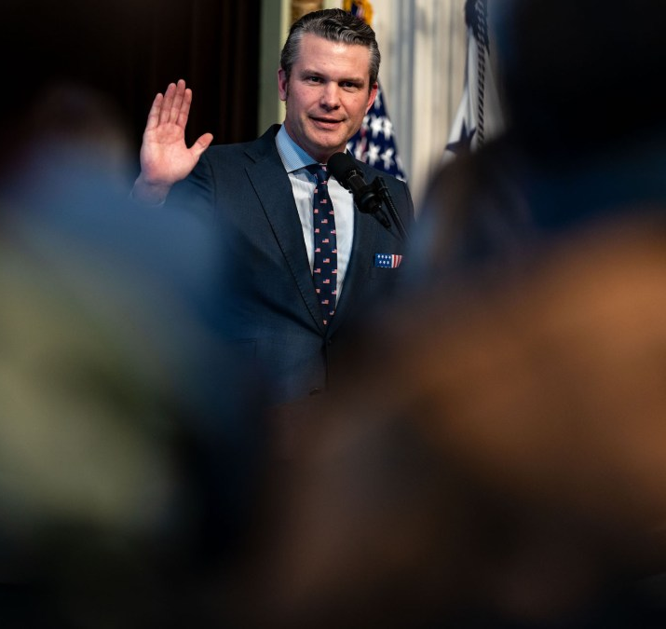
Pete Hegseth confirmed as defense secretary
"I'm straight up just saying we should not have women in combat roles…“We will not stop until trans-lesbian black females run everything.”

Slide 17

Eagles and Chiefs advance to the Super Bowl

Slide 18
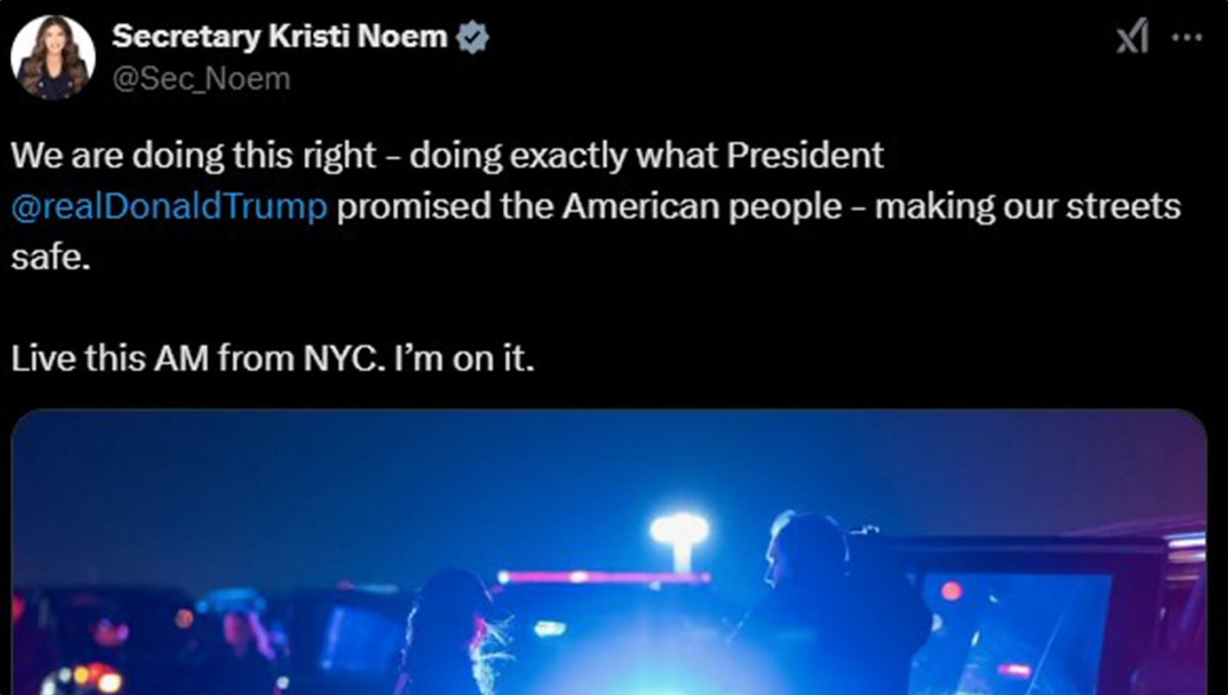
DHS Secretary joins ICE agents making high-profile arrest in the Bronx – January 28, 2025

Slide 19
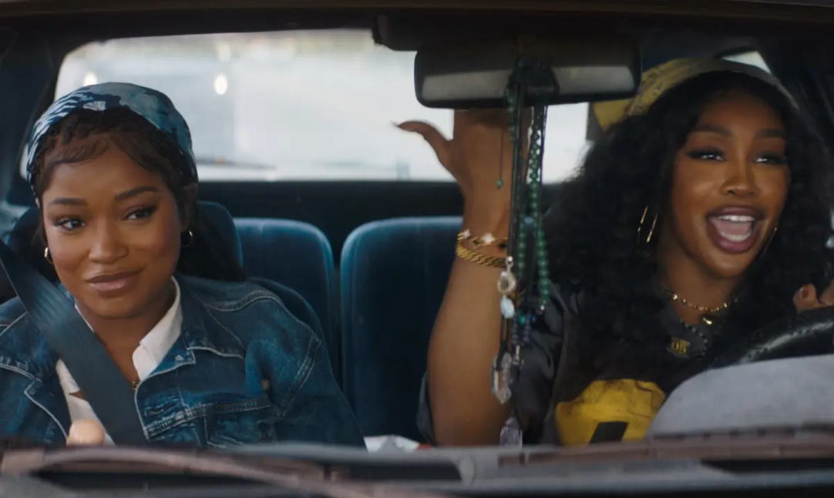
Surprise hit: “One of Dem Days”
(produced by Issa Rae)

Slide 20

New research points to alcohol risks; surgeon general suggests warning labels

Slide 21

A new survey from MetLife paints a picture of Gen Z as disconnected, stressed, and isolated—and a generation that feels less successful than their peers. Researchers spoke to nearly 3,000 full-time employees born between the mid-1990s and early 2010s.

Slide 22
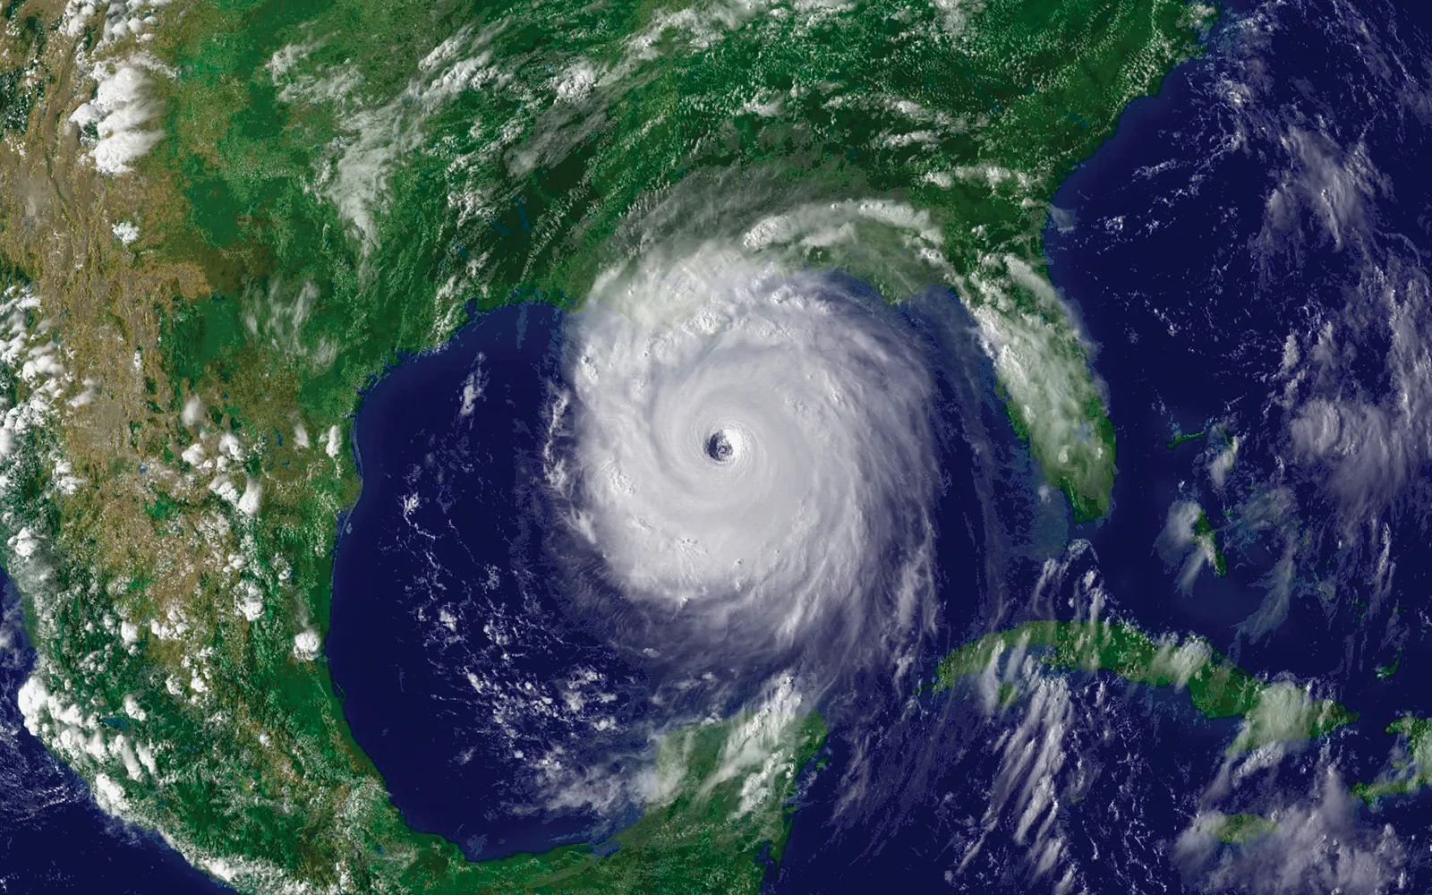
(anniversary)Hurricane Katrina, August 2005

Slide 23

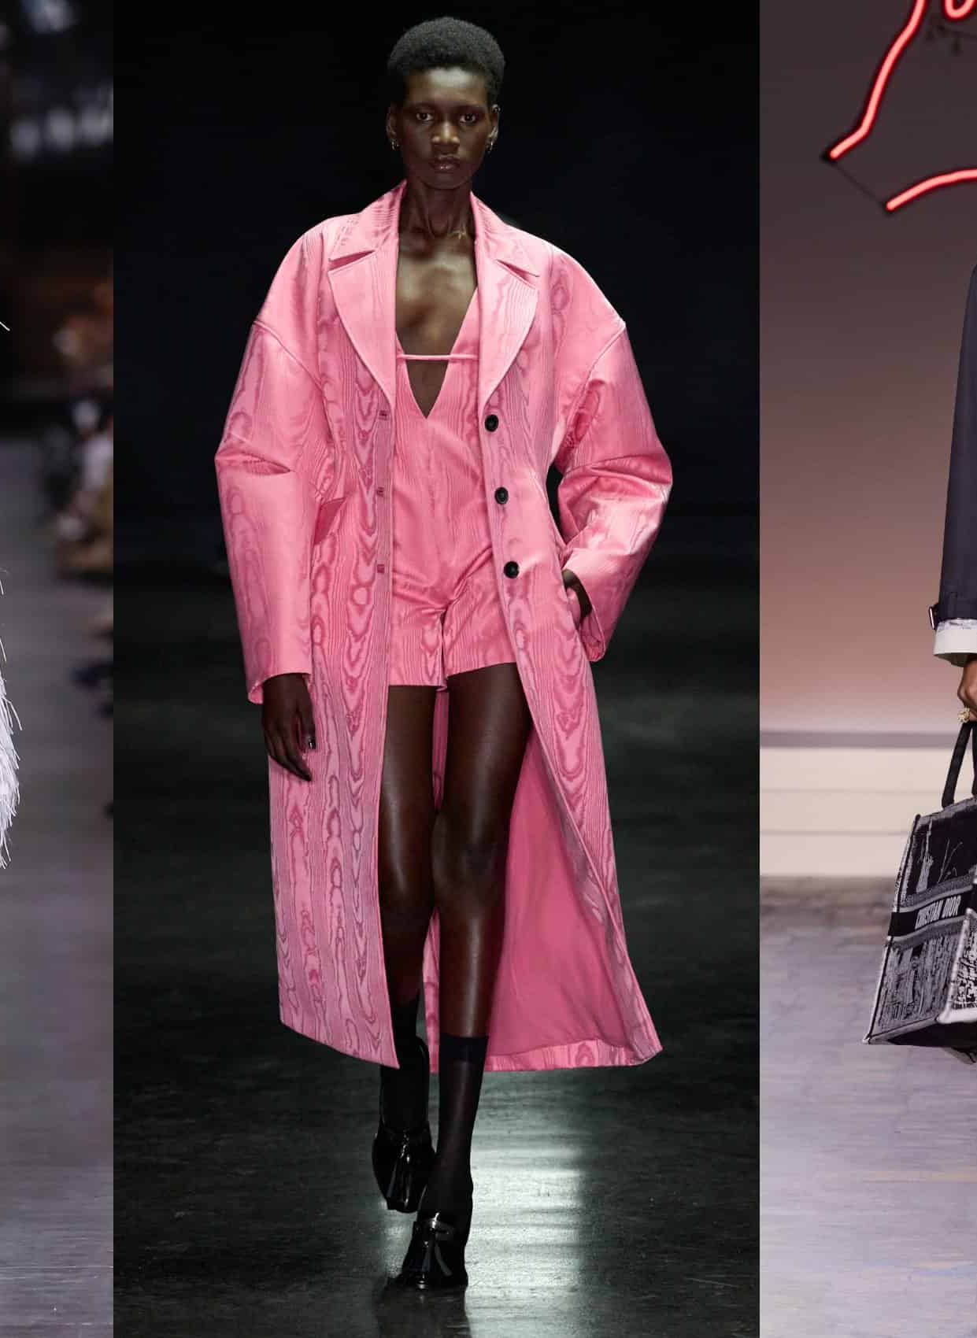
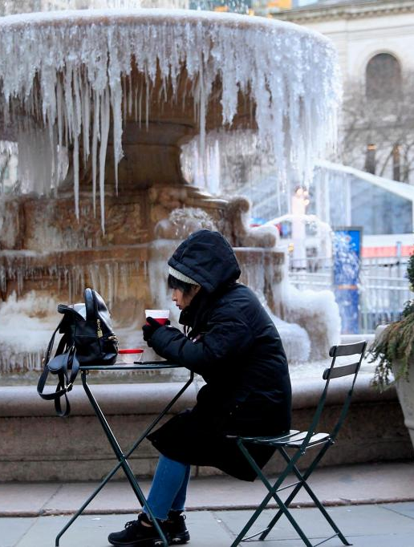

Seasonal

Slide 24
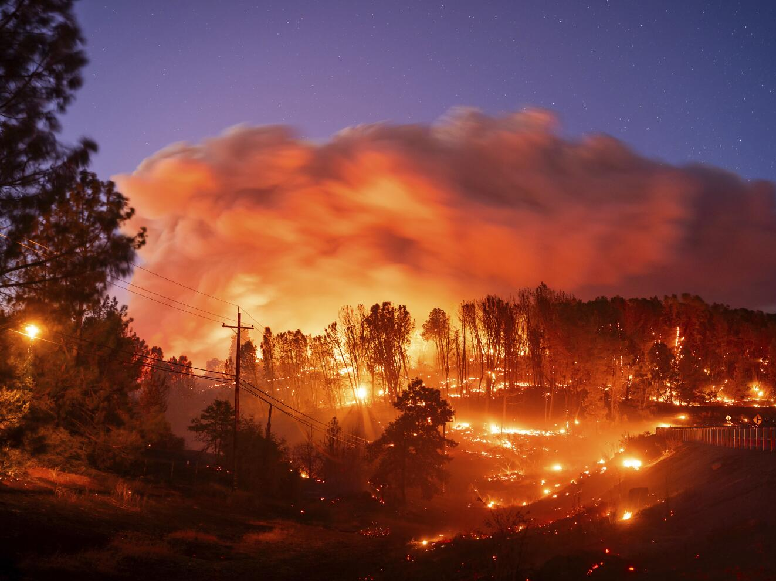
Find a new angle on an ongoing or evergreen story

