Slide 1
The Feature Story Deconstructed

Slide 2
How else is a feature story different from a news story?
Though newsy, not rigidly tied to the news.
It usually touches on a bigger issue than just the obvious.
It has a different structure.
The storytelling is generally more creative.

Slide 3
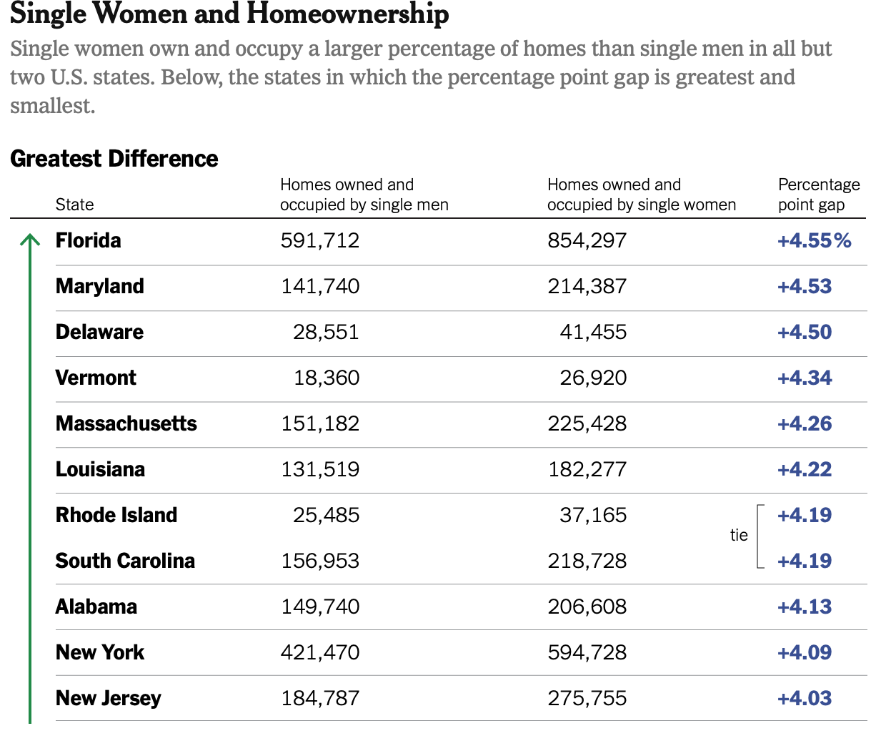
This is the news…
Single Women Own More Homes Than Single Men

Slide 4

This is the news…
Half of black gay men and a quarter of Latino gay men projected to be diagnosed within their lifetime
If current HIV diagnoses rates persist, about 1 in 2 black men who have sex with men (MSM) and 1 in 4 Latino MSM in the United States will be diagnosed with HIV during their lifetime, according to a new analysis by researchers at the Centers for Disease Control and Prevention (CDC). The study, presented today at the Conference on Retroviruses and Opportunistic Infections in Boston, provides the first-ever comprehensive national estimates of the lifetime risk of an HIV diagnosis for several key populations at risk and in every state.

Slide 5
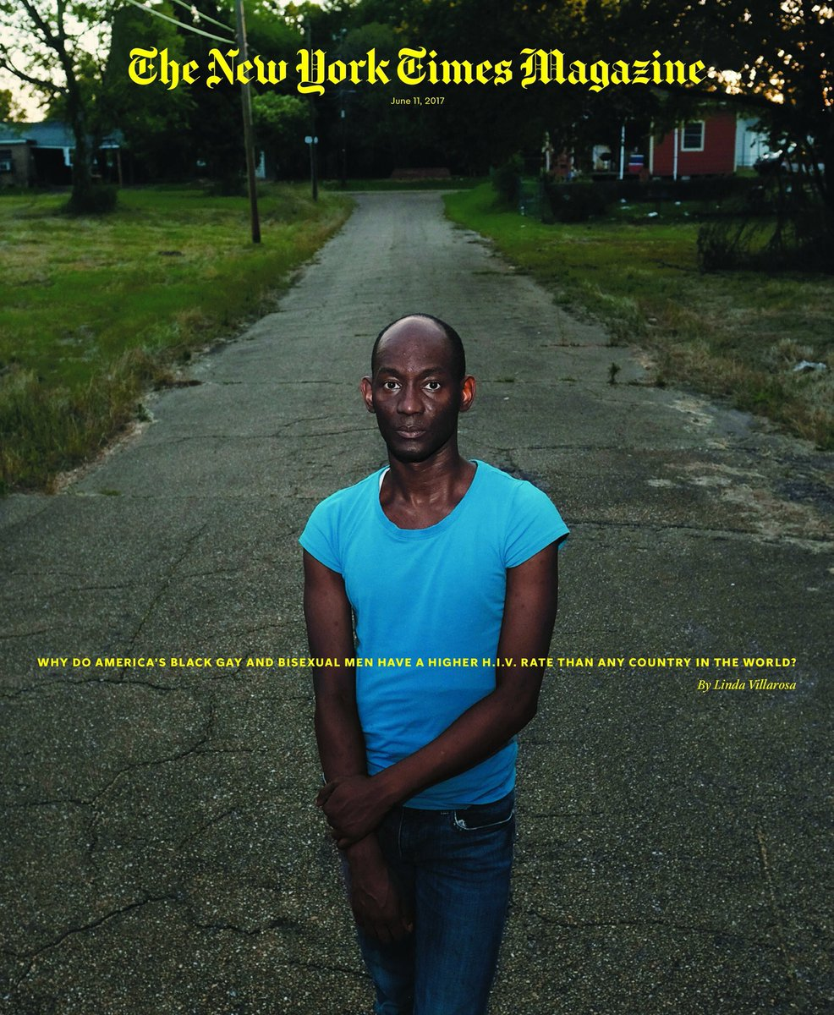
This is the feature…

Slide 6
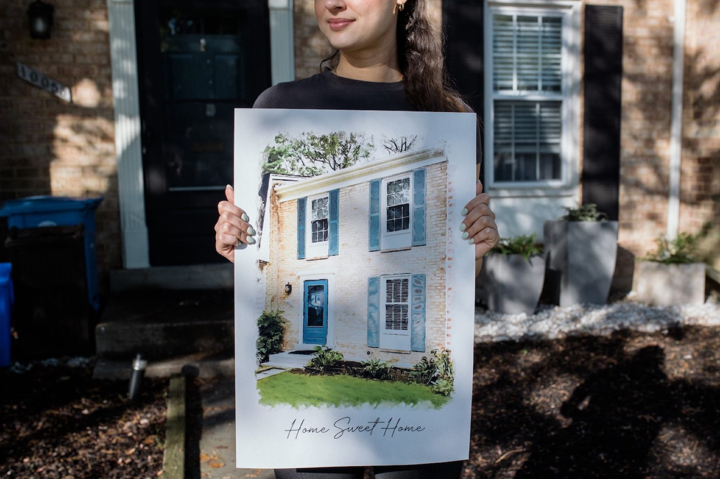
This is a feature…
More single women than men buy homes. That doesn’t mean it’s easy.
From competing against couples to dealing with biased real estate agents and contractors, these are the tales of navigating the housing market alone

Slide 7
The parts of a feature story
Headline
Lede
Nut graph
Body, which includes elaboration, reaction quotes that support the sides of the story--if there are sides.
Ending, conclusion, kicker

Slide 8
Story lede
Story ledes can be one paragraph or a few
Unlike the “just the facts” news lede, the anecdotal lede is generally descriptive and teases the reader
Doesn’t have the “ws”
Often focuses on a person who offers an example of the larger point of the story
Most magazine articles use story ledes

Slide 9
Nut graph, sometimes called billboard
Nut graph is a paragraph (or two) that explains what the story is about.
It contains the facts
Most of the rest of the story supports and amplifies what you’ve written in the nut graph
If you write a strong, clear nut graph, your story will be easier to organize.

Slide 10
Rick Alexander, a master carpenter in Tampa, Florida, has given up searching for a job after months of effort. The disappointment, he believes, has become unbearable.
“When you were in high school and kept asking the head cheerleader out for a date and she kept saying ‘no,’ at some point you stopped asking her,” says Alexander, 41. “It becomes a ‘why bother’ scenario.”
Story lede

Slide 11
Story lede: Rick Alexander, a master carpenter in Tampa, Florida, has given up searching for a job after months of effort. The disappointment, he believes, has become unbearable.
“When you were in high school and kept asking the head cheerleader out for a date and she kept saying ‘no,’ at some point you stopped asking her,” says Alexander, 41. “It becomes a ‘why bother’ scenario.”
Transition: Alexander represents one of a growing number of hidden casualties of the Great Recession.
Nut graph: Every month millions of Americans are left out of the unemployment rate. The official jobless rate, reported last week, rose to 9.7 percent in January. But to be included in that Bureau of Labor Statistics measure, a worker must have actively looked for a job at some point in the preceding four weeks.
For an increasing number of people in this country who would prefer to be working, that is not the case.
Headline: Out of Work, Too Down to Search
Subhed: Why Millions of Americans Have Been Left Off Jobless Rolls

Slide 12
Reminder: parts of a feature story
Headline
Lede
Nut graph
Body, which includes elaboration, reaction quotes that support the sides of the story--if there are sides.
Ending, conclusion, kicker

Slide 13

How can you improve as a journalist?
Read lots of good feature stories.
Pay attention to the format, particularly the story ledes & nut graph/s.
Write, write, write.

Slide 14

This is the news. Write a headline, story lede and nut graph
Government agency webpages about HIV, LGBTQ+ people and multiple other public health topics were down as of Monday evening due to President Donald Trump's executive orders aimed at gender ideology and diversity, equity and inclusion.
Background about HIV/AIDS and other topics as well as entire databases have also been temporarily removed, according to officials at the Centers for Disease Control and Prevention who spoke on the condition of anonymity.

Slide 15
Feature Story Tips
You must write a story lede for the first assignment
Follow feature story format exactly
Understand completely and correctly what the news is
Make sure the “news” is included in your nut graph
Quote at least four people who care about the issue – a mix of experts and affected people.
Word count: 500 to 700 words.

